Slide 1
Chemical Health
Illinois Human Performance Project
Notes:
Welcome to today’s training on Chemical Health! This training is an expanded version of the Chemical Health Guide produced by the Illinois Human Performance Project.

Slide 2
Objectives:
After this training, participants will be able to:
Explain the importance of discussing chemical health
Understand the facts and impact various substances have on our bodies and well-being
Recognize that most students are choosing not to use substances
Develop accountability within themselves, their group of peers, and as a leader
Portray examples of refusal skills and conversational tools to exit out of an negatively influencing situation
Notes:
During this training, we will take the opportunity to learn more about substances a little further in-depth, while providing interactive activities. Read slide.

Slide 3
Why Should We Talk About Chemical Health?
The Importance of Having Difficult Conversations
Notes:
On a piece of flip-chart paper, write down thoughts and ideas of participants as to why they think students should talk about chemical health.
If they are struggling with coming up with ideas, mention the following suggestions:
To maintain positive lifestyles and well-being
To encourage peers to not fall under peer influence
To recognize the standards that coaches, teachers, and parents place on young people
To educate others about the dangers of using substances
To reduce stigma

Slide 4
Notes:
There are 6 individual categories that I am going to highlight for you when it comes to substances impacting our health and well-being.
Read through each of the 6 categories.
Physical: Substances can directly effect our body physically by weight gain/loss, deteriorating oral health, increase for disease and illness such as cancer, impair the immune system, and shorten our lifespan.
Performance: Using substances can impair our ability to perform well in academics, sports, performances, and our day to day tasks and activities.
Biological: Substances can slow down the process of the development of our brain, impair our ability to make decisions, and decrease our levels of cognitive functioning.
Emotional: Substances impact our ability to regulate and control your emotions. Our emotions and feelings can change when substances are used and can lead to depression and anxiety.
Social: Using substances can interfere with our ability to interact with others. Hold yourself and your peers accountable to commit to leading a drug-free lifestyle.
Mood & Mindset: Psychologically, substances can alter our mood, attitudes, and behaviors towards ourselves and others.

Slide 5
Chemical Health Facts & Impacts
Alcohol, Marijuana, Tobacco, Vaping, and Opioids
Notes:
Read slide.

Slide 6
Alcohol Facts
What is it?
Short-term Effects
Long-term Effects
Alcohol is a colorless, flammable liquid containing ethanol that can have intoxicating effects on the body. To consume alcohol, a person must be 21 years of age.
Injury due to falls burns, drowning, alcohol poisoning (which is a medical emergency for having too much alcohol in your blood), and violence.
Cardiovascular disease, cancer, addiction, learning and memory problems, mental health problems, and social problems.
Notes:
Read slide.

Slide 7
How Does Alcohol Impact Performance?
Alcohol use reduces REM cycle deep sleep causing your body to be incapable of reaching the stages of sleep that support long term memory, muscle repair, and body recovery.
1 night of drinking can lead to 14 days of lost training effect.
Alcohol decreases the rate at which your body is able to absorb nutrients and use them as fuel for up to 36 hours after binge drinking.
Notes:
Read slide.

Slide 8
Effects of Long-term Alcohol Use
This brain SPECT scan shows a 38 year old with 17 years of heavy weekend use.
Started at 21 years of age
There are multiple areas lacking blood flow on the surface.
Notes:
Photo and information derived from: https://www.amenclinics.com/spect-gallery/addictions/#img3

Slide 9
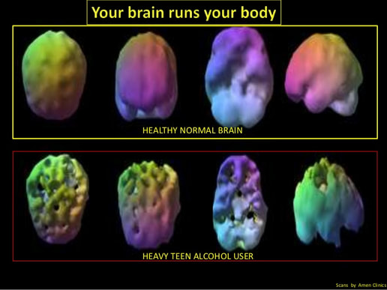
Notes:
Images derived from Dr. Daniel G. Amen at Amen Clinics.
https://www.kindness2.com/coffee--alcohol--brain.html

Slide 10
PSA Video
Notes:
https://www.youtube.com/watch?v=YBEEKWYIpbU
Show the PSA video.

Slide 11
Marijuana Facts
What is it?
Short-term Effects
Long-term Effects
Marijuana also known as cannabis, comes from the hemp plant and contains mind-altering chemicals.
Attention problems, memory and learning problems, and effects on your relationships and mood.
Brain development problems, attention reduction, memory loss, addiction, drop in IQ up to 8 points, mental health problems, and decreased problem solving ability.
Notes:
Read slide.

Slide 12
How Does Marijuana Impact Performance?
Marijuana significantly slows down reaction time even for basic daily tasks.
The THC in marijuana deposits itself all throughout your body-impacting regulation of memory, motivation, cognition, reward system, sensory perception, emotions, motor control, movement memory, and coordination.
Cannabinoids, found in marijuana, increase the secretion of somatostatin which blocks the human growth hormone (HGH), the hormone responsible for growth and repair.
Notes:
Read slide.

Slide 13
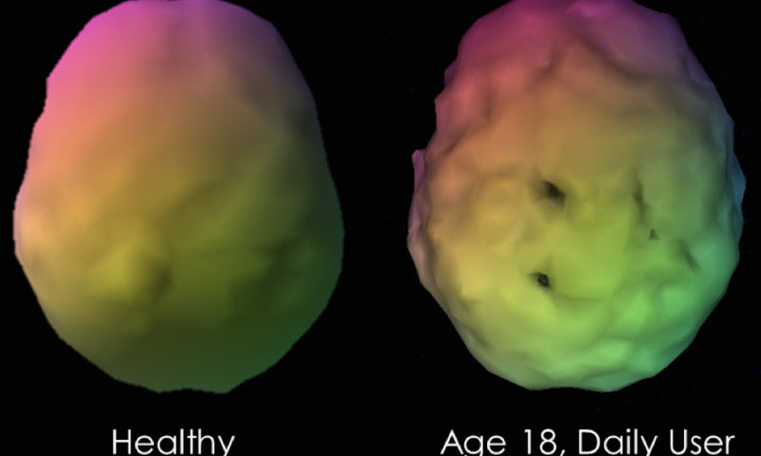
Daily Marijuana User
Demonstrated abnormally low blood flow in virtually every area of the brain studies in nearly 1,000 marijuana compared to healthy controls, including areas known to be affected by Alzheimer's pathology such as the hippocampus.
Marijuana use is thought to interfere with memory formation by inhibiting activity in this part of the brain.
Journal of Alzheimer’s Disease, 2016
Notes:
Image and information derived from: https://medicalxpress.com/news/2016-11-marijuana-users-blood-brain.html

Slide 14
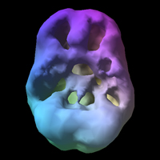
Marijuana’s Effect on the Brain
This brain SPECT image is of a 16 year old who has been using marijuana daily.
Decrease in the prefrontal cortex and temporal lobe activity
Prefrontal Cortex: controls a variety of complex behaviors, including planning, and greatly contributes to personality development.
Temporal Lobe: involved in processing sensory input into derived meanings for the appropriate retention of visual memory, language comprehension, and emotion association.
Notes:
Images and information derived from: https://www.amenclinics.com/spect-gallery/addictions/#img0

Slide 15
PSA Video
Notes:
https://www.youtube.com/watch?v=pfON5TbknTA
Show PSA video.

Slide 16
Tobacco Facts
What is it?
Short-term Effects
Long-term Effects
Tobacco is a leafy plant that contains the addictive chemical, nicotine.
Shortness of breath, impaired lung growth and function, bad breath, and yellow teeth.
Addiction to nicotine, various cancers, impaired immune system, and shortened lifespan (up to 20 years).
Notes:
Read slide.

Slide 17
How Does Tobacco Impact Performance?
Smokers get sick more often because their immune system is lowered. This means you won’t perform as well on tests, competitions, or other performances.
Smoking can lead to easy bodily bruising and can cause strains, sprains, and fractures
Smoking causes a decreases lung health, meaning you will also have a decrease in stamina and performance because your muscles are not receiving enough oxygen.
Smoking reduces blood flow to the muscles, meaning your body needs to work harder to pump blood through your blood vessels.
Notes:
Read slide.

Slide 18
PSA Video
Notes:
https://www.youtube.com/watch?v=pgXziNw9skQ
Show PSA Video.

Slide 19
E-Cigarettes (Vaping) Facts
What is it?
Short-term Effects
Long-term Effects
Electronic Cigarettes, often called vapes are smoking devices used to inhale aerosol containing nicotine, flavorings, and other chemicals.
When using vapes containing nicotine, there is a rush of the hormone “adrenaline” that stimulates the body and causes an increase in blood pressure, heart rate, and breathing.
Vaping has not been around long enough to study long-term effects. However, we know that about 40% of all of the chemicals identified by the FDA as harmful have been found in vapes.
Notes:
Read slide.

Slide 20
How Does Vaping Effect Performance?
Electronic smoking devices can impact our performance by causing attention problems, memory problems, decreased impulse control, and learning capacity
Notes:
Read slide.

Slide 21
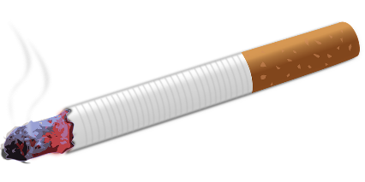
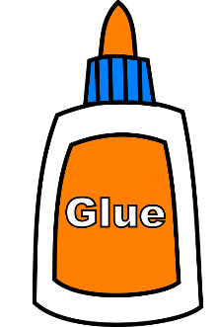
Do You Know What Vape Juice is Made of?
Acetaldehyde
Cadmium
Formaldehyde
Isoprene
Lead
Nickel
Nicotine
Toluene
Benzene
Notes:
Acetaldehyde – alcohol, cigarette smoke, gasoline, and diesel exhaust.
Cadmium – batteries, and a stabilizer for plastics
Formaldehyde – glues, adhesives, disinfectants, plywood, building material and insulation, paint, fabric softeners, fertilizers, pesticides
Isoprene – petroleum, coal tar, playground equipment, plastic and rubber products, adhesives and sealants
Lead – pipes, paint, pencils, car batteries, ammunition,
Nickel – stainless steel, coins, batteries
Nicotine – tobacco products, cigarettes, e-cigarettes
Toluene – paint, metal cleaners, nail polish, adhesives, printing ink
Benzene – plastics, rubbers, dyes, pesticides, gasoline, cigarettes
Resources:
https://pubchem.ncbi.nlm.nih.gov/compound/acetaldehyde#section=Top
https://tobacco.ucsf.edu/9-chemicals-identified-so-far-e-cig-vapor-are-california-prop-65-list-carcinogens-and-reproductive-toxins
https://www.livescience.com/10683-cadmium-dangerous.html
https://www.cancer.gov/about-cancer/causes-prevention/risk/substances/formaldehyde/formaldehyde-fact-sheet
https://www.epa.gov/formaldehyde/facts-about-formaldehyde
https://www.britannica.com/science/isoprene
https://pubchem.ncbi.nlm.nih.gov/compound/isoprene#section=2D-Structure
http://www.rsc.org/periodic-table/element/82/lead
http://www.rsc.org/periodic-table/element/28/nickel
https://www.osha.gov/SLTC/toluene/index.html
https://www.atsdr.cdc.gov/substances/toxsubstance.asp?toxid=14

Slide 22
PSA Video
Notes:
https://www.youtube.com/watch?v=Fxc27gZUbyY
Show PSA Video.

Slide 23
Opioids & Rx Facts
What is it?
Short-term Effects
Long-term Effects
Opioids and Rx are a class of drugs that include the illegal drug heroin, synthetic opioids, and pain relievers that are available by prescription.
Short-term effects can vary when it comes to opioids and prescriptions (Rx) but can include nausea and vomiting, sleepiness, trouble breathing, and trouble concentrating.
Long-term effects can vary but can include addiction, changes in the nervous system, increased blood pressure, and irregular heart rhythms.
Notes:
Read Slide.

Slide 24
How Does Opioids & Rx Impact Performance?
Misusing opioids or prescription drugs (Rx) can cause the risk of dependency which will lead to the inability to stay focused, loss of interests in activities, and the ability to function during day to day activities and/or performances
For more resources and information see the IL HPP Prescription Playbook at https://ilhpp.org/prescription-playbook/
Notes:
Read slide.

Slide 25
Culture and Accountability
Building Accountability and Conversation Tools
Notes:
Let’s switch gears and talk about how now knowing the information about these various substances and how they impact your body and well-being can help you build accountability with your peers and teammates and create a healthy culture!
What many students do not realize is that most students actually do make healthy decisions about their chemical health by choosing not to use substances and choose not to be around them. Sometime, when students do make poor chemical health choices, those situations are discussed more frequently and gain a disproportionate amount of attention compared to non-using choices.
Chemical health is one of the five C’s of leadership characteristics modeled in the IL HPP Student Leadership Manual. Chemical health means supporting zero tolerance of substance use individually and for your group through role modeling, communication, and enforcement. Setting zero tolerance policies is not harsh or unrealistic. These expectations simply create a strong foundation for all to understand and live by!

Slide 26
Building Accountability
Leadership Accountability
Group Accountability
Personal Accountability
Notes:
As a leader, be courageous and proud to say that you are choosing to not using any drugs or alcohol. While it may seem others do not voice this choice, there are many that feel and live the same way and will appreciate your voice to be firm about your values surrounding chemical health. By speaking out about your positive lifestyle choices, you can influence others to feel confident in their decisions to not use also!
To create a consistent culture and message, people must have:
Personal Accountability: Be accountable to yourself. Set an expectation to be drug and alcohol free and recognize how this will help you achieve your goals. Be a model to those around you by not attending social gatherings with substance and using refusal skills when offered a substance.
Group Accountability: You also want to establish commitment and accountability within your team. Encourage one another to keep in line with drug and alcohol free expectations and confront one another without hesitation when something seems out of line of the expectations held upon you.
Leadership Accountability: Lastly, it is important to teach others! Going beyond the first two steps of personal and group accountability means educating other students about the HPP culture and welcoming them to make the same healthy decisions for themselves and their teams or groups of peers. The more people that have the same mindset, values, and positive behaviors influencing one another, the more consistent your message and culture becomes.

Slide 27
Activity
Simon Says
Notes:
We are now going to do an activity, called “Simon Says”. Has anyone ever played this game before?
You each have 5 dots. Take those 5 dots and let’s stand in a circle. We cannot touch each other.
I am going to read off a list of activities. When I say, Simon says, before reading the activity, you should do the activity within 5 seconds. If I don’t say “simon says”, you shouldn’t do the activity.
If you do what I asked when I didn’t say, simon says, or if you don’t do what simon says in 5 seconds, you have to put the sticker on your shirt. The goal is to get as few dots as possible.
Does everyone understand the game?
Let’s start by playing a practice round.
Simon says, scratch your head.
Simon says, pull your ear.
Lift your foot.
Ok! Now that we remember how to play the game, let’s play a round of Simon Says!
Simon says, put your finger on your nose.
Put your elbow on your knee.
Lick your lips.
Simon says, stick out your tongue.
Simon says, wiggle your nose.
Blow a kiss.
Simon says, try to touch your ear with your tongue.
Cross your legs.
Simon says, shake your head.
Smell the inside of your shoe.
Simon says, put your elbow on your knee.
Simon says, suck your thumb.
Simon says, smell under your arm.
Simon says, touch your chin.
Simon says, lick the bottom of your shoe… Simon says, STOP!!!!
The purpose of this activity is to demonstrate how important it is to stick to your personal limit no matter who is pressuring you to cross it.
Which of the things Simon said did not require much thought before you did them? Why were they easy to do?
*Some things are easy to do and don’t require much thinking. Why? Because they do not place us or others in danger, are fun, do not threaten our health, etc.
What did you think/feel when you were asked to suck your thumb or smell under your arm?
*Many people might report feeling uncomfortable. This feeling of discomfort can be important in helping us know that we need to be careful and pay attention because we might be doing something that we won’t be proud of later or we might need to draw a line with someone who is pressuring us.
If you didn’t do something Simon said to do, why was it hard?
*Pressure from someone else can make it hard to do what we think is right. This can include pressure from someone older or pressure from friends.
What did you think/feel when you were asked to lick the bottom of your shoe? If you tried to lick your shoe, what made you decide to do that?
*There are lots of reasons why people sometimes take risks with their health. Those who started to lick their shoes may have felt some curiosity or wanted to show they were brave by taking a risk. Those who refused to lick their shoes were drawing their line or saying NO. Everyone has the right to say NO and draw the line. You are respecting yourself for drawing your line and standing up for yourself by saying, “I won’t do that no matter who’s pressuring me.”
Do you feel that people your age are getting pressured to use substances or other things that they may be uncomfortable with?
Resource: Draw the Line/Respect the Line, ETR

Slide 28
Personal Refusal Skills
“No, thanks.”
“I’d rather not.”
“I have a game this weekend.”
“I signed the HPP Pledge.”
“I’m not into that.”
Avoid gatherings with substances
Call a friend or parent to pick you up if you’re uncomfortable
Host a substance-free gathering
Notes:
Saying, “I don’t”, “I won’t”, or “No, I don’t”. Try not to make excuses, it give the person another attempt to pressure you. Examples of giving excuses might include: “I’ll get in trouble.” “I can’t do it today.”, “I have to go now”.
Resource: Draw the Line/Respect the Line and IL HPP

Slide 29
Other Ways to Say, “NO!”
Walk Away
Change the Subject
Body Language
Notes:
Body language: using serious facial expressions, looking at the person directly in the eyes, crossing arms, moving hands in a “get away” gesture, putting hands on hips, upright posture. Some examples of body language that might indicate a person is not serious or sure of himself/herself include: laughing or giggling while talking, looking at the ground, wiggling or shuffling.
Change the subject: to use this strategy you should suggest another activity that 1. gets you out of the situation 2. is positive 3. is realistic. Changing the subject is a way for you to let the other person know that you don’t want to cross your line, but do want to keep the friendship going. Changing the subject can help cool down a situation, and gives you more time to think about what to say or do if the situation comes up again. It also may distract the other person enough to stop the pressure. Examples: “I’m not ready for this, let’s go get something to eat”. Other ways to start changing the subject include: “Instead, let’s….” “Come on, let’s…” “Let’s go….” “Do you want to….?”
Walk away: There may be some situations in which student should walk away rather than continue to try to resist pressure. This will vary amongst all of you and your peers and across different situations. If you feel uncomfortable, or unsafe, and you don’t think the person who is pressuring you is going to back down, it is probably best to leave the situation and to talk to a trusted adult.
Resource: Draw the Line/Respect the Line

Slide 30
Activity
Chemical Health JeoParody
Notes:
Please go to our website to access this additional PowerPoint presentation with a JeoParody game as an overview to this presentation.

Slide 31
Thank you!
The data in this presentation has been adapted from the National Institute on Drug Abuse (NIDA), Centers for Disease Control and Prevention (CDC), Substance Abuse and Mental Health Services (SAMHSA), US Surgeon General, US Department of Health and Human Services, and John Underwood.

