Slide 1
Constructive Conflict for the Individual
Illinois Human Performance Project
Notes:
This training is surrounding the topic of individual conflict management and confrontation. As we know, dealing with conflict and handling confrontation poses a lot of challenges. During this training, you will learn how to positively deal with conflict and ways to be constructively confrontational as well as managing others confronting you.
Materials:
Dealing with Conflict Animal Activity
Styles Under Stress Test

Slide 2
Objectives:
After this training, participants will be able to:
Define “crucial conversations” through common examples and experiences
Understand how to have difficult conversations with their peers
Identify key components of how to work through and handle confrontation
Utilize new tools for building positive communication
Notes:
Read the following slide

Slide 3
Why do we fear conflict??
Why do we tend to avoid difficult conversations?
What do you think?
Notes:
Pose the questions: Why do we fear conflict? And Why do we tend to avoid difficult conversations?
There are many reasons why conflict can be challenging to overcome. We may be afraid of making matters worse and potentially losing a friendship or relationship from the conflict. We tend to avoid difficult conversations because we may have differing viewpoint and opinions or we might not be sure where to begin the conversation.

Slide 4
Two Doors of Conflict
Right/Wrong Door
Curiosity Door
Notes:
Simply put, there are two doors of conflict that we are planning on talking about.
The first is the right and wrong door. This type of conflict is when we are trying to identify or perhaps place blame on a person for doing something wrong. As an example, conflict can occur when during an athletic competition, a teammate decides to take a different route and ends up getting blocked by an opponent. You decide to confront your teammate and tell them, “You did that play all wrong! If you would’ve went the route we discussed, you could have scored and not caused us the game.” Within this conflict you may encounter peers who always try to “be right” and it will create conflict between a friendship or relationship because they are trying to prove a point.
The second door is the curiosity door. In this type of conflict, you may confront someone simply because you are needing more clarification or a better understanding of why they made the decisions they made. Keeping with the same example you might say to your teammate, “Hey I was open back there, but you ended up going a different route. Did I miss something?” You are simply questioning the actions of others, instead of trying to prove a point of right or wrong.
Sometimes, we naturally choose to go through the right/wrong door rather than the curiosity door based on our flight or fight response. The right/wrong door may be the easier way to go about conflict, however; by choosing to approach conflict through curiosity it provides opportunity to handle challenging discussions and situations in a lighter tone and different lens or perspective.
(Resource: Joe Bush, EGHS Leadership through Service)

Slide 5
What is a Crucial Conversation?
And Why Does it Matter?
Notes:
So what exactly is a crucial conversation and why does it matter? Let’s find out!

Slide 6
CRUCIAL
CONVERSATIONS
Opposing Opinions
Strong Emotions
High Stakes
Notes:
What makes a conversation crucial and not simply challenging, frustrating, frightening, or annoying – is that the result could have a huge impact on the quality of your life. Despite the importance of crucial conversations, we often back away from them because we fear we’ll make matters worse. We’ve become masters at avoiding tough conversations.
To further define a crucial conversation, it is a discussion between two or more people where (1) stakes are high, (2) opinions vary, and (3) emotions run strong.
How do we typically handle crucial conversations?
Avoid them
We face them and handle them poorly
We face them and handle them well
When crucial conversations matter most, we typically do our worst. Why would that be?
We’re designed wrong due to flight or fight response.
We’re under pressure – no books, coaches, or breaks to run to when you’re this kind of predicament.
We’re stumped - You may not know where to start.
We act in self-defeating ways – We’re our own worst enemies
(Resource: Crucial Conversations: Tools for Talking When Stakes are High pgs.2-6

Slide 7
Some Common Crucial Conversations
Ending a relationship
Talking to a peer who behaves offensively or makes suggestive comments
Giving a teammate feedback about their performance
Critiquing a peer’s work
Talking to a team member who isn’t keeping commitments
Discussing problems in an important relationship
Confronting a loved one about a substance use issue
Talking to your parents about college
Telling a boss you’re resigning
Discussing when to say goodbye to a pet
Notes:
Read slide then ask: What are other crucial conversations you may have had to have before or have been apart of?
By learning about crucial conversations it can help us improve our relationships and personal health.
(Resource: Crucial Conversations: Tools for Talking When Stakes are High pgs.8-9, 14-15)

Slide 8
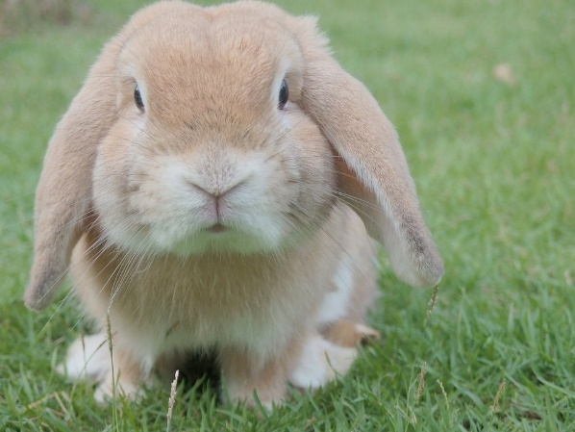
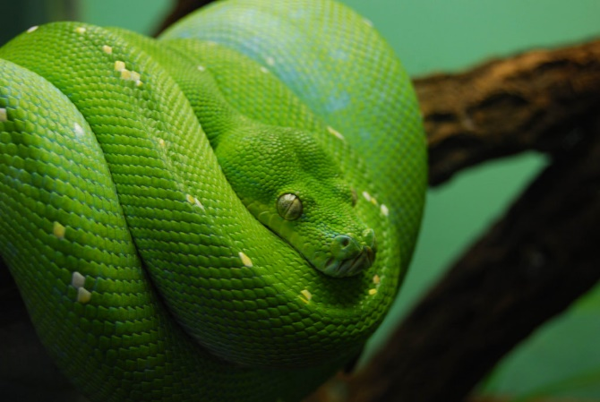
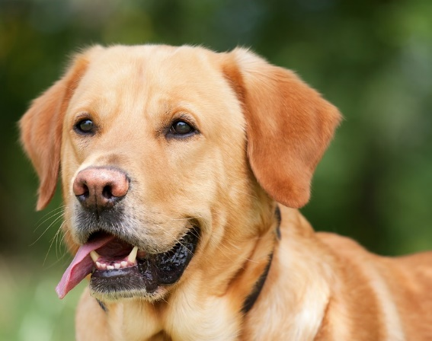
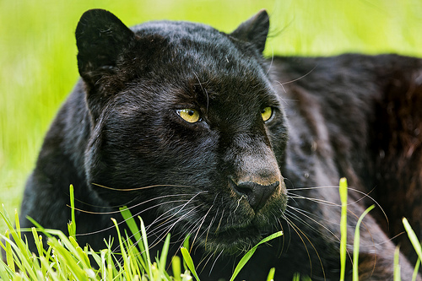
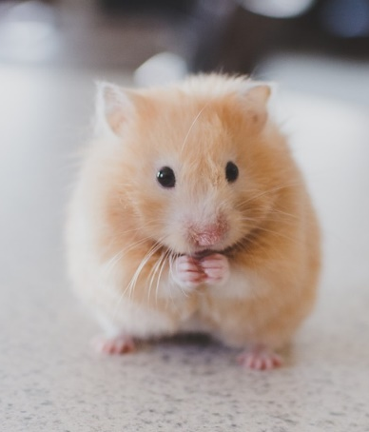
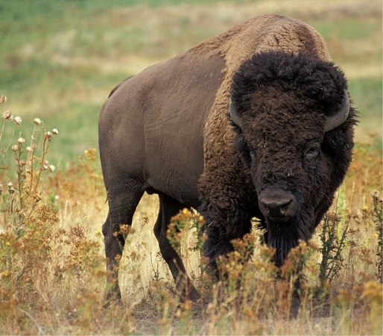
Dealing with Conflict Activity
Whenever you’re in conflict with someone, there is one factor that can make the difference between damaging your relationship and deepening it. That factor is attitude.
William James
Notes:
(15-20 Minute Activity)
Set-up:
Set up the space by either posting the photos of the animals above with a blank piece of paper, or listing their name on individual chart paper.
Each participant will go around the room and write down a response to the following question, “How might this animal respond or react when facing conflict?” Make sure everyone contributes something on each of the papers. After some reflection time, read the notes aloud (or have people read the notes aloud). Next, give the following directions, allowing participants time to consider their answers and move to the appropriate locations.
Round One: “Go to the sheet that lists the things that most represents how you generally respond when faced with a conflict.”
Round Two: “Go to the sheet that best represents how you would ideally want to respond when faced with a conflict.”
Some may choose to stand between two animals. All answers are allowed. Once everyone has decided, ask for a sampling of responses. “What about the behavior of the _______ resonates with you?”
Potential Themes or Metaphors for Learning:
Conflict: Discuss the various ways we respond to conflict. Is there only one correct way? Has it changed over time? Does it change in different situations?
Coping Strategies: Discuss the value of having the skills to respond in many ways according to the occasion.
(Resource: Power of Family)

Slide 9
Learning to Spot Crucial Conversations
Physical Signals: stomach tightens, eyes get watery/dry, face gets flushed and/or red
Emotional Signals: scared, hurt, angry, may react or suppress to these feelings
Behavioral Signals: raising their voice, pointing their fingers, become quiet
Notes:
Now that we’ve learned how animals respond and deal with conflict, lets take a look at how our bodies respond to conversations that are unsettling, hurtful, or frustrating.
Read over the physical, emotional, and behavioral signals of learning how to spot crucial conversations.
(Resource: Crucial Conversations: Tools for Talking When Stakes are High pgs. 54-55)

Slide 10
Start with Heart
How to Stay Focused on What You Really Want
Notes:
One of the first principles of dialogue is to start with heart. That is, your own heart. If you can’t get yourself right, you’ll have a hard time getting dialogue with others right.
People who are best at having dialogue understand this basic principle that, “Work on me first, us second.” As much as others may need to change, or we may want them to change, the only person we can continually inspire, prod, and shape – with any degree of success – is the person staring back at us in the mirror, ourselves.
(Resource: Crucial Conversations: Tools for Talking When Stakes are High pgs.33, 35)

Slide 11
Our lives begin to end the day we become silent about things that matter.
-Martin Luther King Jr.
Notes:
Sometimes silence stands in the way of addressing issues. Why do you think being silent makes a difference on our daily life? How would this impact your HPP chapter if you were to remain silent about the things you felt mattered?

Slide 12
Stop and Ask Yourself..
What do I really want for myself?
“What I want is for my best friend to be more reliable. I’m tired of being let to down by them when they make commitments that I depend on.”
+
“What I don’t want is to have a useless and heated conversation that creates bad feelings and doesn’t lead to change.”
=
“How can I have a candid conversation with my best friend about being more dependable and avoid creating bad feelings or wasting our time?”
What do I really want for others?
What do I really want for the relationship?
Notes:
The second principle is focus on what you really want. It’s important to identify and clarify what you really want for yourself, for others, and for the relationship.
When you find yourself getting heated, changing out your normal behavior for an abnormal behavior, or becoming violent, stop and pay attention to your motives and ask yourself, “What does my behavior tell me about what my motives are?” Once you answer the three questions on the slide, follow up by asking yourself, “How would I behave if this were what I really wanted?”
(Resource: Crucial Conversations: Tools for Talking When Stakes are High pgs.45-47)

Slide 13
Style Under Stress Test
An Interactive Self-Reflection Activity
Notes:
(10 Minute Activity)
Instructions: the following questions explore how you typically respond when you’re in the middle of a crucial conversation. Before answering, pick a specific relationship to reflect on. Then answer the items while thinking about how you typically approach risky conversations in that relationship.
Pass out Styles Under Stress Test.
(Resource: Crucial Conversations: Tools for Talking When Stakes are High pgs.63-69)

Slide 14
Inward | Outward
Masking ⃝ 5 (T) ⃝ 6 (T) | Controlling ⃝ 7 (T) ⃝ 8 (T)
Avoiding ⃝ 3 (T) ⃝ 4 (T) | Labeling ⃝ 9 (T) ⃝ 10 (T)
Withdrawing ⃝ 1 (T) ⃝ 2 (T) | Attacking ⃝ 11 (T) ⃝ 12 (T)
Notes:
Please fill out the scoring sheet. Each domain contains two questions. Next to the question number is a (T). For example, under Masking, question 5, you’ll find a T. This means that if you answered it true, check the box. Your style under stress score will show you which forms of inward or outward you turn to most often. A high score (one or two checked boxes per domain) means you use this technique fairly often. It also means you’re human. Most people toggle between holding back and becoming too forceful.
(Resource: Crucial Conversations: Tools for Talking When Stakes are High pgs.63-69)

Slide 15
Inward Vs. Outward
INWARD
OUTWARD
Masking
Avoiding
Withdrawing
Controlling
Labeling
Attacking
Notes:
Inward consists of any act to purposefully withhold information from the pool of meaning. It’s almost always done as a means of avoiding potentials problems, and it always restricts the flow of meaning.
Masking: consists of understanding or selectively showing our true opinions. Sarcasm and sugarcoating are some of the more popular forms.
Avoiding: involves steering completely away from sensitive subjects. We talk, but without addressing the real issues.
Withdrawing: pulling out of a conversation altogether. We either exit the conversation or exit the room.
Outward consists of any verbal strategy that attempts to convince, control, or compel others to your point of view. Methods range from name-calling and monologuing to making threats. The three most common forms are controlling, labeling, and attacking.
Controlling: coercing others to your way of thinking. It’s done through either forcing your views on others or dominating the conversation. Methods include cutting others off, overstating your facts, speaking in absolutes, changing subjects, or using directive questions to control the conversation.
Labeling: putting a label on people or ideas so we can dismiss them under a general stereotype or category.
Attacking: You have moved from winning the argument to making the person suffer. Tactics include belittling and threatening.
(Resource: Crucial Conversations: Tools for Talking When Stakes are High pgs.58-61)

Slide 16
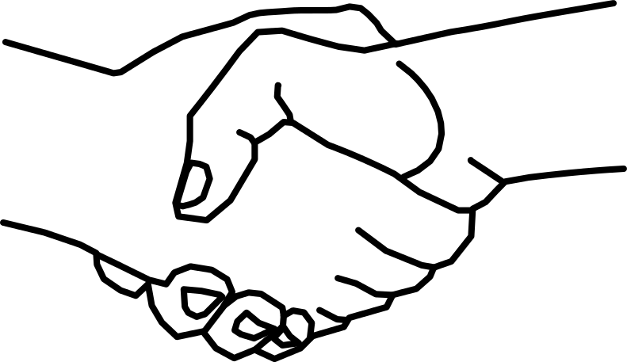
Mutual Purpose & Respect
How to Make it Safe to Talk About Almost Anything
Notes:
Mutual purpose means that others perceive that you’re working toward a common outcome in the conversation, that you care about their goals, interests, and values. And vice versa. You believe they care about yours. “Do others believe you care about their goals in this conversation? Do they trust your motives?”
Mutual respect is asking yourself, “Do others believe you respect them?”
One way to show respect and show that you care is ask and make sure you have a full understanding of their perspective to portray your respect for them.
(Resource: Crucial Conversations: Tools for Talking When Stakes are High pgs.73, 101)

Slide 17
When Mutual Respect or Purpose is at Risk
Apologize
Contrast
Create a Mutual Purpose
C: Commit to Seek Mutual Purpose
R: Recognize the Purpose Behind the Strategy
I: Invent a Mutual Purpose
B: Brainstorm New Strategies
Notes:
Apologize when Appropriate
When you’ve made a mistake that has hurt others, start with an apology. An apology is a statement that sincerely expresses your sorrow for your role in causing-or at least not preventing pain or difficulty to others.
Example: “I’m sorry I didn’t text you when I learned that I had to stay home to babysit my brother. I know you’ve been working really hard on this performance and it would’ve been really helpful to have had more time to work on it together. I will do better to communicate if I can’t come over in the future. I apologize.”
Contrast to Fix Misunderstanding
Contrasting is a don’t/do statement that:
Addresses others’ concerns that you don’t respect them or that you have a malicious purpose. (the don’t part)
Confirms your respect or clarifies your real purpose. (the do part)
Example: (the don’t part) “The last thing I wanted to do was communicate that I don’t value you the hard work you have put into this play or that I didn’t want to share it with the director.” (the do part) “I think your effort has been nothing short of amazing!”
Once you have addressed the threat to safety, you can return to the issue and move to remediation:
Example: “Unfortunately, just when I was starting to get ready to leave, my mom told me she needed to go to the grocery store and I had to watch my brother. I will talk to my mom about how important this performance is to you and I and I know she will be willing to run errands around our practices.”
Contrasting is not apologizing. Contrasting provides context and proportion.
Create a Mutual Purpose
Commit to seeking a mutual purpose - By staying in the conversation until you come up with something that serves everyone.
Recognize the Purpose Behind the Strategy – Ask people why they want what they want and what they are pushing for. Separate what they’re demanding from the purpose it serves.
Invent a Mutual Purpose – See if you can invent a higher or longer-term purpose that is more motivating than the ones that keep you in conflict.
Brainstorm new strategies - With a clear mutual purpose you can join forces in searching for a solution that serves everyone.
(Resource: Crucial Conversations: Tools for Talking When Stakes are High pgs.85-102)

Slide 18
Partner Activity Scenario
You and your teammate were both invited to a party Saturday where you knew there was going to be alcohol and vaping. You made the decision to not go to the party and instead, went out to dinner with your cousins. Your teammate was influenced by another group of athletes to go to the party, and they went. You found out through another teammate via text and are disappointed in their decision. You are now back at school Monday and have to have a crucial conversation about commitment to the goals and creed you have set as a chapter.
Notes:
(5 Minute Activity)
Have students get into pairs and read through the scenario. One student will be the teammate who went out to dinner and the other will be the teammate that went to the party.
Using the steps on the previous slide about mutual respect or purpose being at risk, have students role play how they can get back to mutual respect and purpose.

Slide 19
Crucial Conversations & Building Skills
Ways to Improve Communication Surrounding Conflict
Notes:
Part of managing conflict is to use effective communication strategies to overcome the challenges within the relationship at risk. At this point in the training, we will now learn some additional skills to better prepare for handling conflict and begin the resolution process.

Slide 20
Conversation Guidelines
Do not "hit and run."
Communicate openly and directly your perceptions of, and feelings about, the issues in the conflict.
Comprehend as completely as possible the other person's views of, and feelings about, the conflict.
Value disagreement over the issues and the opportunity to work through that disagreement.
Do not demand change.
Invite the other person to confront you about your behavior.
Don't preach to or interpret for the other person.
Notes:
Here are some conversation guidelines to help you out.
(Resource: https://oregonstate.edu/instruct/comm440-540/confront.htm )

Slide 21
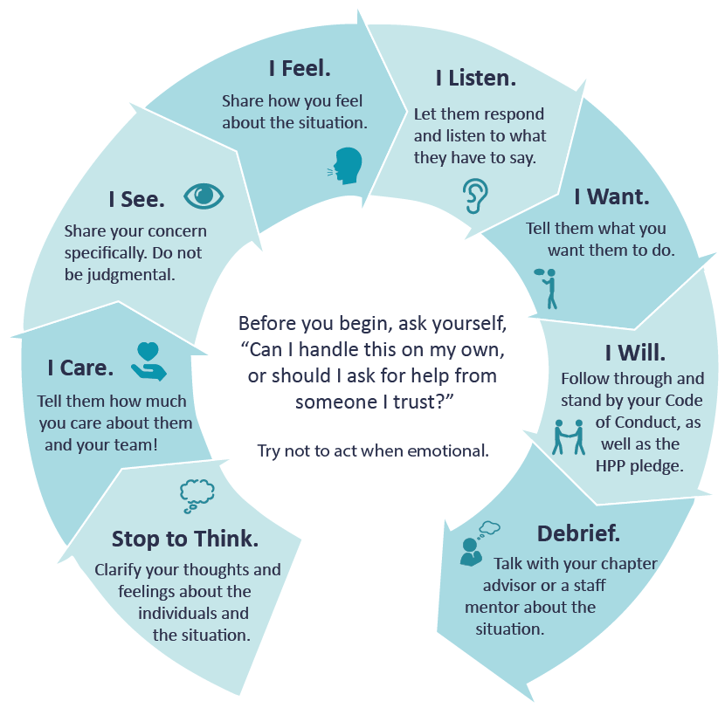
Confrontation Skills
Notes:
Confrontation Skills A confrontation about actions should be specific and timely. It should be conducted in a way that helps the other party examine the consequences of her/his behavior rather than causing her/him to defend her/his actions.
This is a model to help you feel ready to calmly and collectively express a concern or address a conflict helping you have more effective conversations about potentially tough topics. (Read through cycle out loud). The more these steps are practiced, the more comfortable you’ll feel each time you have a conversation with a friend, teammate, or peer.
(Resource: https://oregonstate.edu/instruct/comm440-540/confront.htm and HPP)

Slide 22
WWA Approach
W: WHAT HAPPENED? Focus on the specific
behavior that bothers you.
W: WHERE or WHEN? Focus on last time
it happened. Avoids “you always/you never.”
A: Explain how it AFFECTED you, how it made you
feel, or why it bugs, upsets you, or makes you mad.
Notes:
Another tool that can be used when addressing conflict is to use the WWA Approach. Simply put, consider the WWA Approach. The objective is to think about the What (specific behavior), the When or Where (it happened last), and to state how it Affected you.
Remember too, hearing complaints from others could be an opportunity for one person to let another person know how and why something affects or bothers them.
(Resource: Love Notes, Dibble Institute)

Slide 23
WWA Examples
Positive: “Last week when we were working on our middle school presentation and you didn’t show up, it made me feel like you no longer want to be involved with our group.”
Negative: “You’re so selfish! You never want to come to any of our planning meetings!”
Positive: “It made me angry when you told me I suck at basketball at practice Monday.”
Negative: “You never tell me I’m good enough!”
Notes:
Read the following examples on the slides.

Slide 24
Crucial Conversations: In Summary
Understand yourself
See & become comfortable with the value of crucial conversations
Practice with the different models provided
Crucial conversations can have a really positive impact on your culture
Notes:
In summary, it’s important to know yourself and how you may respond to potentially difficult conversations. By having these crucial conversations however, we begin to have the confidence to address others in a more productive matter, particularly when using some of these provided models. This will continue to encourage an open conversation culture that allows for greater communication and collaboration among your peers.

Slide 25
Thank You!!
For Additional Trainings & Resources Visit: www.ilhpp.org !
This was developed and funded in whole and or part, by grants from the Illinois Department of Human Services and Substance Abuse and Mental Health Services Administration. The views, opinions, and content of this publication are those of the authors and contributors, and do not necessarily reflect the views, opinions, or policies of IDHS, SAMHSA, or HHS, and should not be construed as such.

