Slide 1
Training Objectives
After this training, participants will be able to:
Identify aspects of their personal commitment & accountability
Understand elements necessary to create group commitment & accountability
Recognize the importance of establishing leadership commitment & accountability to empower others to foster personal and group commitment and accountability to create a culture of excellence
Notes:
(For instructor reference)

Slide 2
Creating Leadership Accountability
Human Performance Project
Notes:
INTRO:
Many, if not all of you have been introduced to the Human Performance Project and now know that this project’s purpose is not only to educate people in the performance based science modules, but also equip them to commit and lead their peers in these ground breaking concepts. This workshop is to prepare you individually and as a group in your commitment accountability to yourself, your chapter/teams, and your peers. The hope is that these concepts will help you gain the skills to not only more adequately empower others to learn and create change in their lives, but also give you the tools and resources to train and empower your peers to have a great and successful HPP chapter and culture!

Slide 3
A Staircase of Empowerment
Personal Commitment
Group Commitment
Leadership Accountability
Personal Accountability
Group Accountability
Notes:
We will talk about how the concepts of commitment and accountability become an evolutionary cycle of empowerment the more people are involved and dedicated to the project at hand. This three tier process takes us through commitment and accountability from a personal, group, and leadership standpoint. Let’s begin!

Slide 4
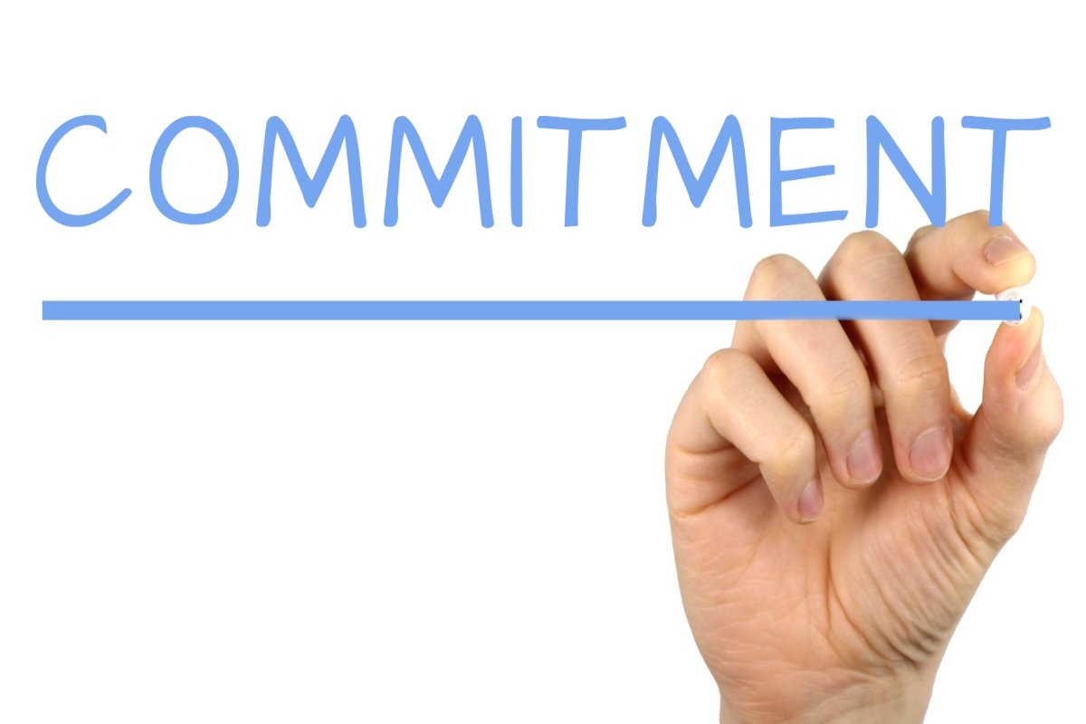
Notes:
(Ask:) What does Commitment mean to you? (sample concepts to solicit: promise, something I say I’ll do, etc.)
Exactly! Ultimately, commitment is about a buy-in and a promise to a particular cause. It answers questions like ‘what’ (you’re doing) and ‘why’ (you’re doing it). It is a promise that dedicates you to a passion. It is important to recognize how this differs from being interested in something. We as humans have many things that peak our interest, but what you are willing to dedicate more of your time to in order to follow through and do well, is commitment.

Slide 5
Notes:
(Ask:) What does Accountability mean to you? (sample concepts to solicit: follow-through, doing what I say I’ll do, etc.)
Yes! Accountability is the follow-through to a commitment. This answers the question ‘how’ by designating the steps taken to complete and follow through on the promised commitment.

Slide 6
PERSONAL Commitment & Accountability
What matters to you, why, and how do you do it?
Notes:
So, let’s take a look at the 3 ways to view these concepts. Let’s get started…. with YOU!
(PERSONAL COMMITMENT) Take a look at your worksheet and think of something in your life that you are committed to. Remember, this isn’t something that you’re just interested in, but really have a passion for and are committed to doing well. Maybe this is your sport, your club, your HPP Chapter, or even a class. Take a minute to figure out what you feel is the most important commitment to you in your life at this time and write it down.
Once you think of it, write down all of the reasons why this commitment means so much to you. Maybe it ties into your values, maybe you feel great when you do it, or maybe this is something you’ve always done and can’t imagine life without. Take time to give this thought and write down all the reasons you can think of.
(Time permitting: Does anyone want to share their what and why of commitment?)
(PERSONAL ACCOUNTABILITY) Being committed to something is great- but it really doesn’t hold a lot of weight if you don’t make it happen, right? Breaking your commitment doesn’t just make you untrustworthy- but it doesn’t get anything accomplished. To fulfill the promises you make to yourself or others, follow-through and accountability are key! What are the specific steps that you take to make your example commitment happen? Don’t be vague– write out specifically what you do day in and day out, step by step, to live up to that promise you’ve made for yourself.
(Time permitting: Does anyone want to share their how of commitment?)
Many, if not all, of you are already seeing levels of commitment and accountability within yourself that you might not have known were already there! Way to go!

Slide 7
Don’t Make Excuses!
I don’t have enough time
If only we had more people
That doesn’t work with my schedule
That’s not my job
I can’t trust my team member
I don’t know how; no one taught me
(Worrall, 42)
Notes:
(Signs of Poor Accountability: “Accountability Leadership, (Worrall, 42)”)
Personal Commitment is not easy; and Personal Accountability is even harder! Don’t give up; you can do it! Watch out for these signs that times are getting tough and keep your head in the mindset of success- the only person that can truly make your passion happen is you. So, if you see yourself starting to struggle, refocus. Give yourself the time and space to revisit these goals- the what, the why, and the how of what really makes you happy and don’t give in. The best thing is that you’re not in it alone. Everyone has a passion and commitment for something. Even if you have different passions, turn to your friends, your family, your teachers, your coaches- and be accountability partners for one another. And for those of you who find others who have the same passions and commitments as you– you’re in luck too, because THAT becomes GROUP COMMITMENT AND ACCOUNTABILTY!

Slide 8
GROUP Commitment & Accountability
What matters to the team, why, and how do you all do it?
Notes:
The concepts of commitment and accountability are still the same – they mean the same thing and have the same intention – but the audience shifts. Instead of what matters to you, it is now what matters to the team. Instead of why something matters to you, it becomes why it matters to the group- and how you get these group commitments accomplished, depends on how you all fulfill those goals as a team.
Group Commitment is all about finding common goals and values among those you’re working with. In your worksheet you talked about why you chose to commit to your activity. This probably had a lot to do with your values and what you want out of your life. Finding common ground among many people can be a process- but it is well worth the effort. Hang tight, and we’ll give you a couple of tips to help make that process more comfortable!
Group Accountability is about being able to hold one another to the commitments agreed upon. This is a layered process, but we’ll help you through that too!
Let’s start to take a look at an example. Divide into partners or groups with those of you who have the same goals and values and can identify a group commitment you would like to make. As a team, take a look at the bottom half of your worksheet. Together, think of a commitment that you would like to take-on. Maybe this is something for your HPP Chapter, an athletic team, or an extracurricular club. Maybe you’re looking to set up an event, achieve a certain performance goal, or grow your program. Whatever it is, make sure this is actionable- make sure you fully intend on bringing this back to your chapter to implement- and MAKE SURE YOU ALL AGREE ON THIS COMMITMENT.

Slide 9
Results
Accountability
Commitment
Constructive Conflict
Trust
(Lencioni, 188)
Notes:
(From: “The 5 Dysfunctions of a Team” by Patrick Lencioni)
Alright. Take a break from your group discussion. This is a model for creating optimally functioning groups. You see at the top, that as many things in life, results are the end goal. Wining the big game, having a sold out performance, or putting together an awesome HPP event! But to achieve the best results possible with your group, several things need to happen first.
As you can see establishing trust and the ability to have constructive conflict are foundations to developing commitment. Simply meeting and briefly getting to know others is beginning to set the foundation for trust- spending time with those on your team or getting to know someone on a personal level continues to build the trust you share with someone. Energizers, ice breakers, and team building activities will also continue to help foster the continue trust growing process. These types of activities are even methods you can bring back to others in your groups or teams to help them along the same process. This phase of team development is where you really begin to build your own character and ability to show that you care for the others that you’re working with (Worrall, 28).
Conflict. Often times conflict has a negative connotation, but we can say from our experience as a staff team, that conflict has been an awesome growth opportunity for our goals and our projects. Really, having constructive conflict is healthy discussion and communication about everyone’s ideas to find the most common goals and values a group shares. You can see how that if you haven’t established a foundation of trust, being comfortable in voicing your opinion among your group may be difficult. But by already having built that trust, you know that your voice will be heard and that your teammates will take that into fair consideration.
(Ask:) How many of you had a healthy discussion about what project you wanted to commit yourselves to on your worksheet? (pause for show of hand) Without even knowing it, you were taking yourself through this process! By following the pathway of building trust and having constructive conflicts you should ultimately be able to lead yourself to developing some pretty clear and specific goals. These become your commitments, just like you did on your worksheet.
(If time: does anyone want to share what commitments you all set for yourself?)
Conveniently, you can see that all of these steps leading to commitment are actually the foundational pieces for Group Accountability as well. By bringing your group to a place where they have collectively established and agreed upon clear and specific actionable goals, you are setting the vision for what you are holding your peers accountable to. The tricky part of Group Accountability is really the willingness to call each other out on following through on commitments. If things aren’t getting done or you are seeing someone struggle to get their part accomplished- don’t wait for someone else to jump in- ask how you can help: check in and ask why things are tough- you never know what the barrier might be if you don’t ask.

Slide 10
Notes:
Now I’m going to have you take a few minutes with your team to complete the last section on your worksheet and brainstorm SPECIFIC and ACTIONABLE steps that will help hold you accountable to following through on the commitment you agreed to.
When setting steps to follow through on your commitments, make them SMART!
S: SPECIFIC: be as clear as you can about what you’re looking to accomplish
M: MEASURABLE: place a numeric value to track your success
A: ATTAINABLE: be reasonable about setting a challenging, yet realistic expectation
R: RELEVANT: action steps should pertain to the commitment established by the team
T: TIME BASED: set a start and end date to your goal and/or set benchmark times that you will achieve each aspect of your goal.
The bigger the project, the more goals you may need. Sub-goals are also important to keep in mind when really working on a large-scale project.
As you collectively work on your worksheet, remember you can always look back to your individual examples if you need help thinking through this process.

Slide 11
LEADERSHIP Commitment & Accountability
SUPPORTING OTHERS IN…
what matters to them, why, and how do they do it?
Notes:
Being a team player comes in many forms. Just like we’ve been talking about within Group Commitment & Accountability, being a cooperative and willing teammate is important. But how can you take it one step further? Leadership Commitment & Accountability is really about taking the initiative to facilitate and support forward movement among your peers. Again, the concepts are the same, but in leadership commitment you ask yourself what matters to them and why and how do they do it.
You can’t just simply become a leader of commitment and accountability to others. You first need to live out these concepts on a personal and a group level, just like we’ve discussed through your worksheet. Knowing what it means to make commitments and be accountable to yourself and to a group will lay the foundation for you to teach and exemplify those skills to others.
Through leading by example, being a role model, mediating discussions, and delegating project tasks, you begin to help your peers make progress towards being more successful.

Slide 12
teach!
facilitate!
Notes:
Leadership Accountability encompasses a lot of different skills of leadership. These are a few to specifically consider while fostering commitment and accountability in others:
TEACH: Educate others about the causes that are important to your group, such as the HPP science modules, culture
ASK: Ask questions to those you are mentoring to help yourself understand what is important to them so they can begin to establish what matters to them and why and how they plan on working towards their goals. Asking questions prompts others to think about their passions in a way they might not have before. Your job is to simply ask, and then listen to their responses.
Questions to consider may include:
-What activity are you focusing on at the moment? (club, sport, personal, project, etc.)
-What is particularly important to you when thinking about this area of your life?
-Why is this meaningful to you?
-What steps might help you reach your end goal?
FACILITATE: Be able to facilitate discussion & problem solving as individuals or groups are trying to figure out their commitments and how to achieve them. This isn’t always an easy process, so be patient! Understanding and recognizing how your role as a facilitator and leader can impact the outcomes of your group can really inspire you to help move your group forward.

Slide 13
Notes:
(Facilitation continued)
As you already know from discussing group commitment and accountability, developing trust and having constructive conflicts are key to building the foundation for commitment and accountability. Building a culture of accountability to achieve the best results includes: developing clear and concise expectations/commitments as a group, allowing all members participate and be heard in discussions, valuing and respecting team members for who they are and what they bring to the table, and giving recognition and acknowledgement for those peers who truly lead the way.
Facilitating positive encouragement is a big job and can be so rewarding! But being able to do all of these things and more is critical in order to make your team feel like a cohesive group.
(For more tips and training on facilitation skills, please view the IL HPP Facilitation Skills training resources)

Slide 14
TEAM>TEAMMATE>SELF
Notes:
Building a positive, supportive culture is really about putting others first. Work toward the good of the whole and ask yourself if your decisions are in the best interest first of your team or group’s purpose. If not, then it is probably not the right choice to achieve your goals. If your decisions are for the good of your team, and the good of your teammates, then they will most likely be for the good of yourself as well. Overall, this concept of group leadership and accountability comes down to this one simple model: team>teammate>self. Be true to yourself, true to your teammates, and most importantly true to your whole team. With that,

Slide 15
Notes:
(Time Permitting: funny accountability video: https://www.youtube.com/watch?v=UF0EoMW0J78)
To leave you all, with something to laugh about: (watch video)
Most problems are easy; just get off the escalator! Don’t forget– that while it seems obvious to some, commitment and accountability don’t always come easy! Stay true to yourself and to your group and if you can, go above and beyond to help others reach their goals too!

Slide 16
Sources
Lencioni, Patrick. The Five Dysfunctions of a Team. San Francisco: Jossey-Bass, 2002
Worrall, Di. Accountability Leadership. Carlton NSW Australia: The Accountability Code, 2013
https://www.youtube.com/watch?v=UF0EoMW0J78
This was developed and funded in whole and or part, by grants from the Illinois Department of Human Services and Substance Abuse and Mental Health Services Administration. The views, opinions, and content of this publication are those of the authors and contributors, and do not necessarily reflect the views, opinions, or policies of IDHS, SAMHSA, or HHS, and should not be construed as such.

