Slide 1
Mood & Mindset
Illinois Human Performance Project
Notes:
Welcome to today’s training on Mood and Mindset! This training stems from the Mood and Mindset Guide produced by the Illinois Human Performance Project.

Slide 2
Objectives:
After this training, participants will be able to:
Explain the importance of discussing mood and mindset
Understand the impact our mood and mindset has on our bodies and well-being
Develop accountability within themselves, their group of peers, and as a leader
Portray examples of ways to reduce stress
Explain the interconnectedness of mood and mindset with other science modules discussed through the Human Performance Project
Notes:
During this training, we will take the opportunity to learn more about mood and mindset a little further in-depth, while providing interactive activities. Read slide.

Slide 3
Why Should We Talk About Mood & Mindset?
The Importance of Having Difficult Conversations
Notes:
On a piece of flip-chart paper, write down thoughts and ideas of participants as to why they think students should talk about mood and mindset.
If they are struggling with coming up with ideas, mention the following suggestions:
To maintain positive lifestyles and well-being
To recognize the expectations that coaches, teachers, and parents place on young people
To recognize the expectations that young people place on themselves
To educate others about the negative impacts of a poor mood and mindset
To reduce stigma
It’s value to better grades, nutrition, sleep, attitude, and relationships

Slide 4
Why Talking is Important!
Mood and Mindset
Influences your ability to perform
Interconnected with so many other components of your life including sleep, nutrition, and chemical health
Young people face a lot of stress!
Makes a difference in achieving your goals
Notes:
It’s important to acknowledge and recognize how large a factor mood and mindset plays in our everyday lives. Our moods are a constant rollercoaster from both positive and negative moods, feelings, and emotions and to understand and reflect on how you’re feeling in any given moment and how you are going to react to those feelings will play a large role in your ability to perform optimally.

Slide 5
What is Stress?
Notes:
Stress is the body’s response to a physical or emotional demand. Contrary to common misperceptions, stress is not always a bad thing. Stress can help us stay focused, energetic, and alert and even save our lives through our innate “fight or flight” response — (e.g.) giving you extra strength to defend yourself, intensified alertness to avoid a coiled snake mere feet in front of you, or quick reactivity to slam the brakes of your car to avoid an accident.
Unfortunately, stress can come to affect us in other negative ways that can disrupt our health, mood, productivity, relationships, and quality of life if we are not careful. Common types of negative stress can accumulate from problems within our relationships, extremely busy workloads at school or in a career, and tragedies or losses involving a family member or close friend.
By determining what type of stress (good or bad) that you are experiencing in any given moment, you can adapt your attitude, outlook, and plan of action on the source of stress and respond in the most appropriate and healthy way.
Not only knowing what stress is, but how your body and emotions are impacted by the stress that surrounds you is important. Practice recognizing your stressors, the way you respond to it, and what positive ways you can help your body work through stressors to become more resilient!
What is Stress? - http://www.stress.org.uk/what-is-stress/
https://www.helpguide.org/articles/stress/stress-symptoms-signs-and-causes.htm
NIH (Things to Know) - https://www.nimh.nih.gov/health/publications/stress/index.shtml

Slide 6
Activity: Cast of Characters
Notes:
Let’s jump into an activity where we will see how the various stressors in life can impact our ability to perform.
Use the Cast of Characters handout for instructions and complete the activity. ¹Broderick, Patricia C. “Theme R: Reflections.” Learning to Breathe A Mindfulness Curriculum for Adolescents to Cultivate Emotion Regulation, Attention, and Performance, by Patricia C. Broderick, New Harbinger Publications, 2013, pp. 49–50.

Slide 7
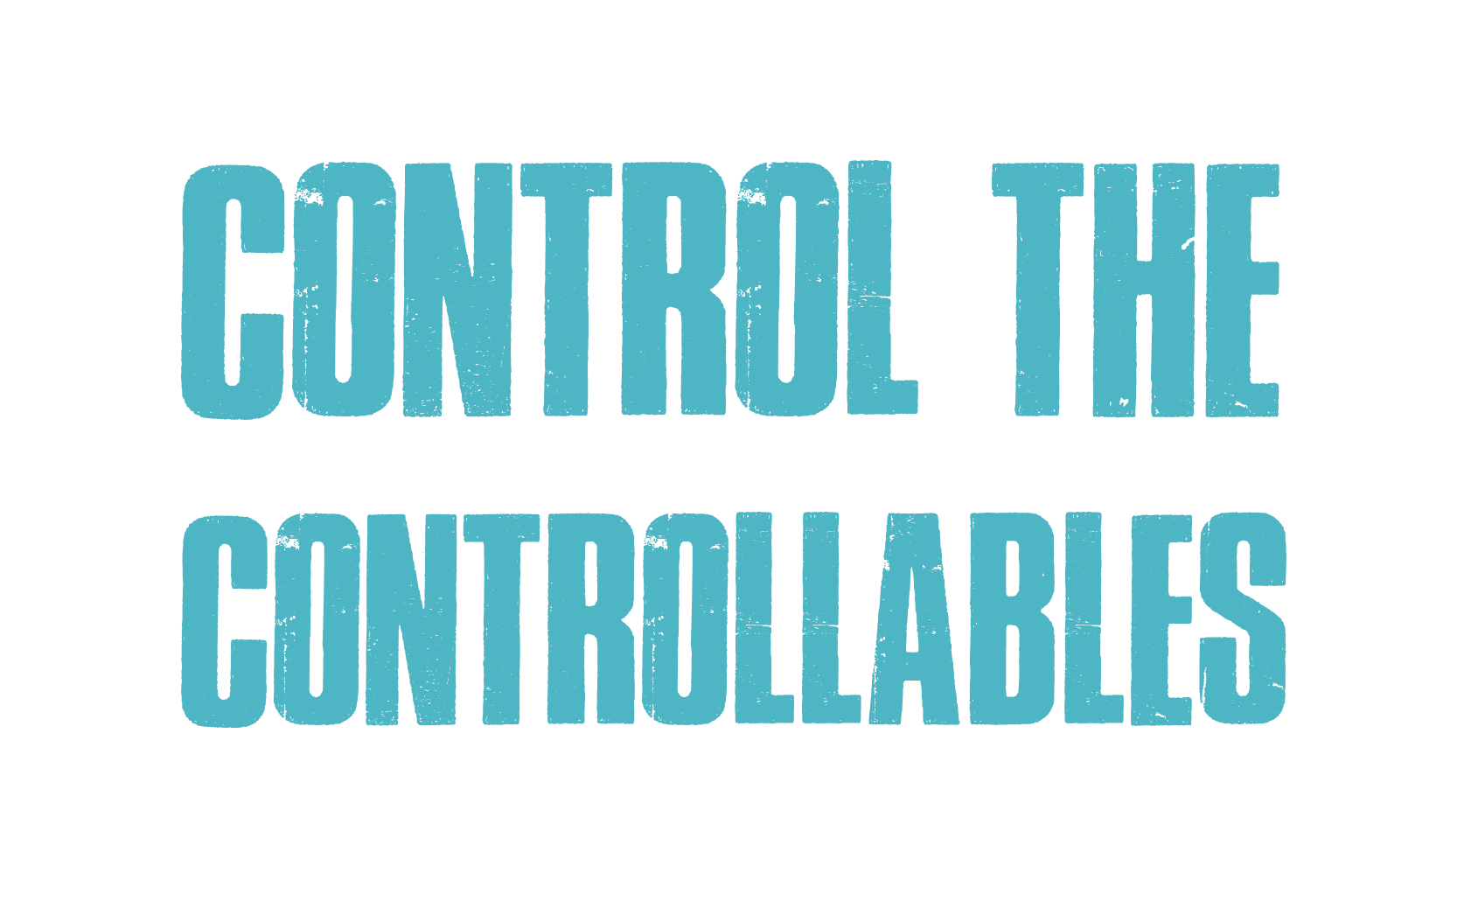
Notes:
In the book Chop Wood, Carry Water, Author Joshua Medcalf discusses the idea of “controlling the controllables”. There is only so much in your day to day life that you have control over.
Tell me some things that you have control over? (Have students respond)
Tell me some things that you do NOT have control over? (Have students respond)
The key to this, is how you respond to the controllables.

Slide 8
Can You Choose Your Attitude?
E + R = O
“Things turn out best for those who make the best of the way things turn out.”
-John Wooden, UCLA Men’s Basketball Coach
10%
Event
+
Response
=
Outcome
90%
Notes:
But, can you REALLY choose your attitude? What do you think?
In answering this question maybe it’s not really your attitude that you are choosing more that it is your behavior – and your behavior may reflect your attitude or your mindset.
The formula E+R=O was recently discovered in a book written by Urban Meyer, Head Football Coach at Ohio State University. The formula plays out like this –
E(event) + R(response) = O(outcome) So how do you respond? How do you respond when things go well? How do you respond when things go poorly? Your response will help to reveal your attitude and mindset. A great quote that corresponds to this formula is from John Maxwell “Life is 10% of what happens to me, and 90% of how I react to it.” (Click to show the 10% and 90%)
“…if we choose to see the world as out to get us, then that is how we will experience it. But of course, the flip-side of that is also true: if we choose to see the world as a generally positive, supportive place, then that is how we will experience it.” – Alison McWilliams, PhD Huffington Post
So, which do you choose? Do you choose to see the world you exist in as generally positive and supportive or is your world out to get you? The choice you make will shape your attitude and mindset and most importantly your R(response), how you respond to any E(event) will greatly determine the end O(outcome). And regardless of the circumstance, you possess the great POWER to control your R. And in controlling your R – you will control your O(outcome).

Slide 9
Stress Management Tips
Ways to incorporate tools and techniques into your daily life
Notes:
There are many ways to manage your stress and the most effective ways will be different based on what works for each individual. Stress management is a practice that all people can benefit from. Whether you’re thriving in life, or feeling extremely overwhelmed, practicing regular self-care, coping strategies, and stress management techniques can enhance your future health and well-being (Varvogoli and Darviri, 2011). The following are examples of how you can manage stress with your body, actions, and mind.

Slide 10
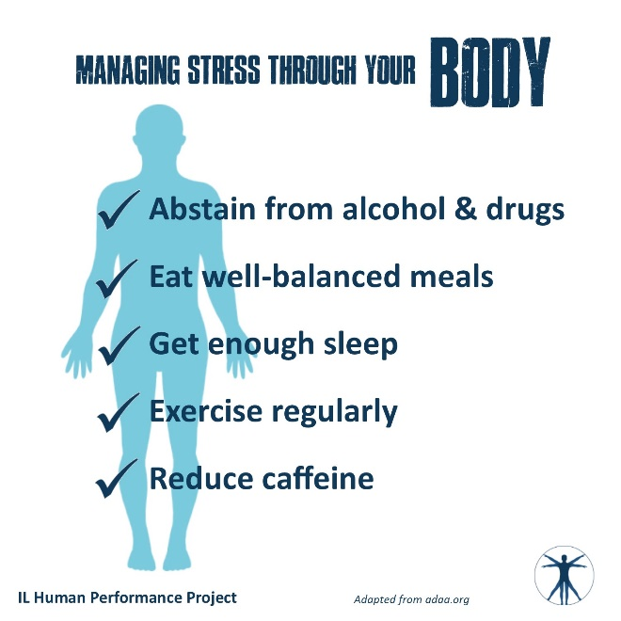
Notes:
Read Slide.

Slide 11
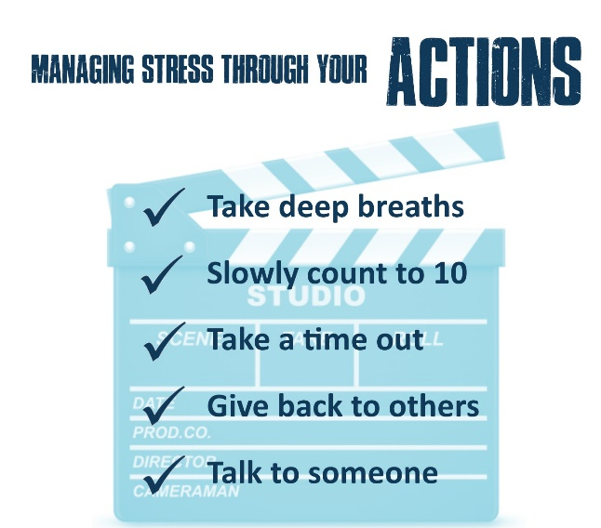
Notes:
Read Slide.

Slide 12
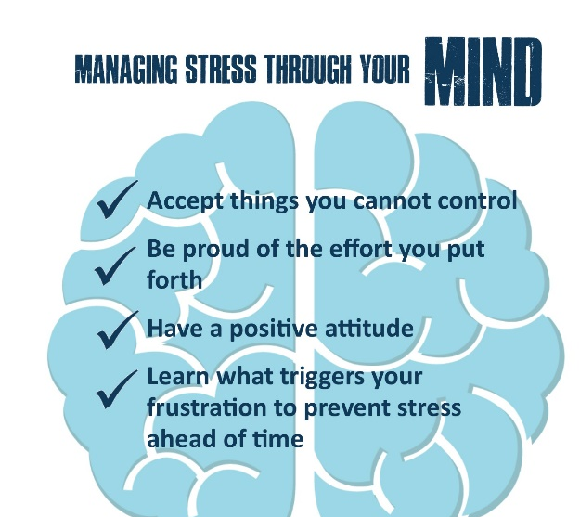
Notes:
Read Slide.

Slide 13
The Power of Gratitude
Improves overall sense of well-being
Achieve a higher satisfaction for life
People are more agreeable, more open, and less neurotic
Strengthens interpersonal relationships
More willing to forgive others
Increases our overall happiness, health, and well-being!
“Learn to be thankful for what you already have, while you pursue all that you want.” – Jim Rohn
Notes:
The power of gratitude and positivity can play a significant role in our performance. Gratitude is “the appreciation of what is valuable and meaningful to oneself and represents a general state of thankfulness and/or appreciation” (Sansone & Sansone, 2010).
By expressing gratitude, you are improving your overall sense of well-being and are achieving a higher satisfaction for life. Studies show that grateful people are more agreeable, more open, and less neurotic (McCullough et al., 2002; McCullough, Tsang, & Emmons, 2004; Wood, Maltby, Gillett, Linley, & Joseph, 2008; Wood, Maltby, Stewart, Linley et al., 2008). “Gratitude is also a powerful tool for strengthening interpersonal relationships. People who express their gratitude tend to be more willing to forgive others and less narcissistic (DeShea, 2003; Farwell & Wohlwend-Lloyd, 1998).” “Recent research performed in 2015 showed that patients with heart failure, who completed gratitude journals showed reduced inflammation, improved sleep, and better moods thus dramatically reducing their symptoms of heart failure after only 8 weeks.” Practicing gratitude can significantly increase our overall happiness, health, and well-being, and there is clear science and evidence to prove this.
Practice gratitude by writing a handwritten letter to someone you are grateful to have in your life and deliver it to them in person. Afterwards you may experience a boost in mood that could last a few months!
Resources:
https://positivepsychologyprogram.com/gratitude-appreciation/
https://www.tandfonline.com/doi/abs/10.1080/17439760902992464

Slide 14
Progressive Muscle Relaxation (PMR)
Can be done anytime throughout the day
Helps you learn how to relax and release tension
How it Works:
Physically tense an isolated muscle group (such as your legs) for 10 seconds and then relax the same isolated muscle group for 20 seconds. Repeat with different muscle groups of the body such as your abdomen, chest, arms, and face.
Notes:
Progressive Muscle Relaxation (PMR) is something that can be done at any time throughout the day. While sitting at your desk or waiting in a line at the grocery store, PMR can help you learn how to relax and release tension. PMR is practiced by physically tensing and then relaxing isolated muscle groups throughout your body. Start by focused on the legs, move to the abdomen, check, arms, and eventually your face. Purposely tense the specific muscle group for ten seconds, and then release and relax the same muscle group for 20 seconds. With practice, this physical and mental activity can help you learn how to relax in a short period of time. (Varvogoli and Darviri, 2011).
http://citeseerx.ist.psu.edu/viewdoc/download?doi=10.1.1.851.7680&rep=rep1&type=pdf

Slide 15
Activity: Body Scan
Notes:
Falling asleep or simply relaxing ourselves can be challenging for many of us. From racing thoughts, to “not being tired”, there are different ways to relax and gain calmness. One way to do so is through a body scan. Let’s practice by participating in a short 20-minute body scan.
Use the Body Scan Book Activity handout for instructions and complete the activity. ¹Broderick, Patricia C. “Theme B: Body.” Learning to Breathe A Mindfulness Curriculum for Adolescents to Cultivate Emotion Regulation, Attention, and Performance, by Patricia C. Broderick, New Harbinger Publications, 2013, pp. 38–43.

Slide 16
When things feel tough: Ask for help!
Don’t hesitate to reach out to a:
Teacher
Parent
Coach
Social Worker
Faith Leader
Trusted Family
Let’s talk about mental health!
Notes:
Sometimes our mood & mindset don’t align with how we want to be feeling. Mental health is just as important as our physical health and is important to address if you don’t feel like yourself. Sometimes nervousness or stigma cause hesitation to seek support, but think about it: when someone breaks a bone, no one questions when that person seeks medical support or care. The same goes for people’s mental health: when our emotions and mindset don’t align with how we want to feel, getting help is important!
Whether it is for you or a friend, reaching out to others for help is never a bad idea. Think about who those trusted adults are for you so you can reach out to them if you or someone you know is looking for some extra support!

Slide 17
How Does Mood & Mindset Connect to Other Science Modules?
Learning how sleep, nutrition, mood and mindset, and chemical health are all interconnected
Notes:
Mood and Mindset, Chemical Health, Sleep, and Nutrition are all connected! The choices you make in one area of your life are actively impacting the choices you make in others. Here are a few ways that your mood and mindset interact with the other modules:

Slide 18
Mood and Mindset: Sleep
It only takes a few nights of shortened or restricted sleep for adolescents to experience worse moods and a decreased ability to regulate their emotions.
Notes:
Sleep: It only takes a few nights of shortened or restricted sleep for adolescents to experience worse moods and a decreased ability to regulate their emotions. (Braum et al, 2013)
https://onlinelibrary.wiley.com/doi/abs/10.1111/jcpp.12125

Slide 19
Mood and Mindset: Chemical Health
Using psychoactive drugs, such as marijuana or alcohol, can cause mood disturbances like anxiety, mood swings, depression, sleep problems, and psychosis. The effects of drug use on mood can be both short-term and long-term.
Notes:
Chemical Health: Using psychoactive drugs, such as marijuana or alcohol, can cause mood disturbances, like anxiety, mood swings, depression, sleep problems, and psychosis. The effects of drug use on mood can be both short term and long term. (drugs.ie)
http://www.drugs.ie/drugs_info/about_drugs/mental_health/

Slide 20
Mood and Mindset: Nutrition
Food choices are impacted by one’s mood. A good mood increases the chances that someone will make a healthy food choice, while a bad mood increases the chances that someone is going to make an indulgent food choice.
Notes:
Nutrition: Research shows that food choices are impacts by one’s mood. A good mood increases the chances that someone will make a healthy food choice, while a bad mood increases the chances that someone is going to make an indulgent food choice. (Gardner, Wansink, Kim, Park, 2014)
https://foodpsychology.cornell.edu/discoveries/feeding-your-feelings
https://www.sciencedirect.com/science/article/pii/S1057740814000060

Slide 21
Culture and Accountability
Building Accountability and Conversation Tools
Notes:
Building accountability:
Creating a positive, supportive culture is critical to the success of individuals, groups, and community. Sometimes, it can be challenging to maintain a positive mood & mindset, but the more you practice and the more people who also strive to remain positive, the more natural it becomes. An individual’s mood and mindset influences their decisions to maintain healthy nutrition, get enough sleep, and abstain from drugs and alcohol, but your mood and mindset also impacts your performance. Being confident and having a strong outlook on a challenge ahead provides you greater opportunity for success. The same goes for groups or teams. If everyone’s head is in the game and focused on your challenge ahead, the group is more likely to reach their goals and be proud of their approach in doing so. Never forget the power in holding yourself and others accountable to a positive mindset.

Slide 22
Culture and Accountability
To create a consistent culture and message people must:
Personal Accountability: First, strive to have a positive and optimistic personal viewpoint on life, activities, and how you spend your time.
Group Accountability: Second, encourage others to live out an uplifting and supportive mindset to influence those around them.
Leadership Accountability: Third, show others how they too can empower their peers to maintain this positive lifestyle.
Notes:
To create a consistent culture and message people must:
Personal Accountability: First, strive to have a positive and optimistic personal viewpoint on life, the activities you are involved with, and those that you spend time with. Being positive and supportive around others demonstrates an ideal mindset for all.
Group Accountability: Second, encourage others to live out an uplifting and supportive mindset to influence those around them. Your influence can help them see that their attitude and behaviors impact others and they have the power to shape the mindset of those around them.
Leadership Accountability: Third, show others how they too can empower their peers to maintain this positive lifestyle. You can educate others about the impact of positive mood and mindset on performance so they understand the value of this approach. Then, they too can practice personal, group, and leadership accountability to help influence a strong, supportive culture.

Slide 23
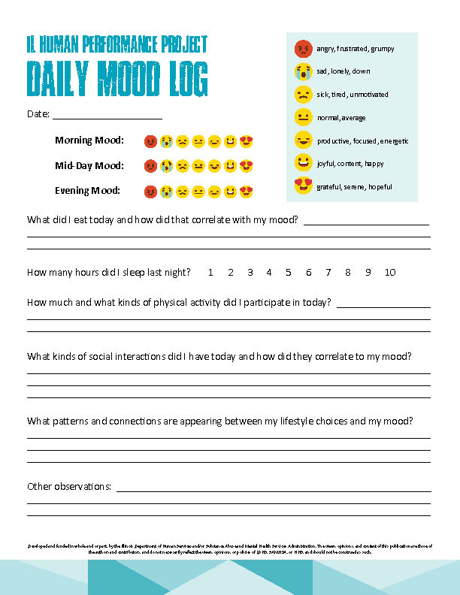
Daily Mood Log
To help you track your mood and factors that may contribute to it, use the Daily Mood Log handout to keep track of your mood each day.
Notes:
Use the Daily Mood Log handout to track the factors that impact mood to learn your patterns of behavior and help hold you accountable to choices that positively impact your mood.

Slide 24
Questions?

Slide 25
Thank you!

