Slide 1
Nutrition
Illinois Human Performance Project

Slide 2
Objectives:
After this training, participants will be able to:
Explain the importance of discussing nutrition
Understand the impact our nutrition has on our bodies and well-being
Develop accountability within themselves, their group of peers, and as a leader
Recognize different meal options for different daily physical activity
Explain the interconnectedness of nutrition with other science modules discussed through the Human Performance Project
Notes:
During this training, we will take the opportunity to learn more about nutrition a little further in-depth, while providing interactive activities. Read slide.

Slide 3
Why Should We Talk About Nutrition?
The Importance of Nutrition
Notes:
On a piece of flip-chart paper, write down thoughts and ideas of participants as to why they think students should talk about nutrition.
If they are struggling with coming up with ideas, mention the following suggestions:
Fuels our bodies and provides us energy
Influences other decisions we make
It’s a daily decision
Helps to know the different types of food groups, sources, and how each food item benefits our health and well-being

Slide 4
Why Talking is Important!
Nutrition
Influences your ability to perform
Interconnected with so many other components of your life including sleep, mood and mindset, and chemical health
Young people may not know all the answers about nutrition and it’s impact on the human body
Makes a difference in achieving your goals
Notes:
It’s important to acknowledge and recognize how large a factor nutrition plays in our everyday lives. Eating healthy foods and drinking water and staying hydrated are essential to the human body. If you aren’t eating enough, or aren’t getting the right nutrients – it can affect other areas of your life and cause you to be tired, feeling uncomfortable, cause sleep disturbances, and so much more.

Slide 5
Hydration
Notes:
Let’s take a moment to watch this short Ted Ed on the importance of water! To follow along, there is an easy worksheet for you to fill in the blanks as we watch this video.
Print handout “Ted Ed Water Notes Activity” for each participant.
Activity taken from: https://www.familyconsumersciences.com/2016/07/water-the-overlooked-nutrient/

Slide 6
Activity: Meme Creation
Notes:
Using this meme generator site https://imgflip.com/memegenerator, work individually, in pairs, or in groups and create two memes!
The first meme should be a did you know… fact about water/hydration.
The second meme should be a phrase, statement, or message to students to encourage drinking more water!
Activity taken from: https://www.familyconsumersciences.com/2016/07/water-the-overlooked-nutrient/

Slide 7
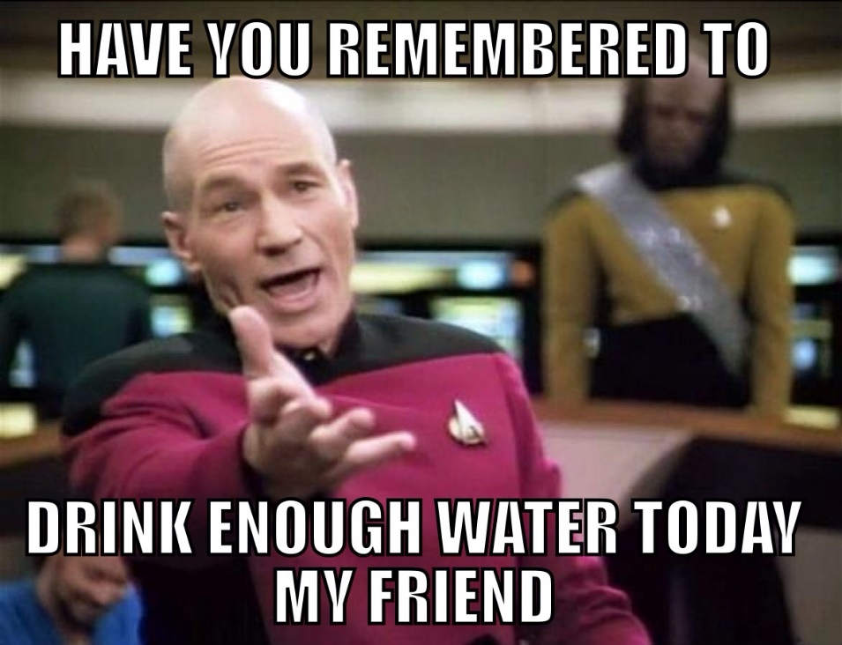
Meme Examples
Notes:
Activity taken from: https://www.familyconsumersciences.com/2016/07/water-the-overlooked-nutrient/
As a chapter, you can take these memes and utilize them in your social media, on screens on your school campus, or print them and hang them up in visible areas!

Slide 8
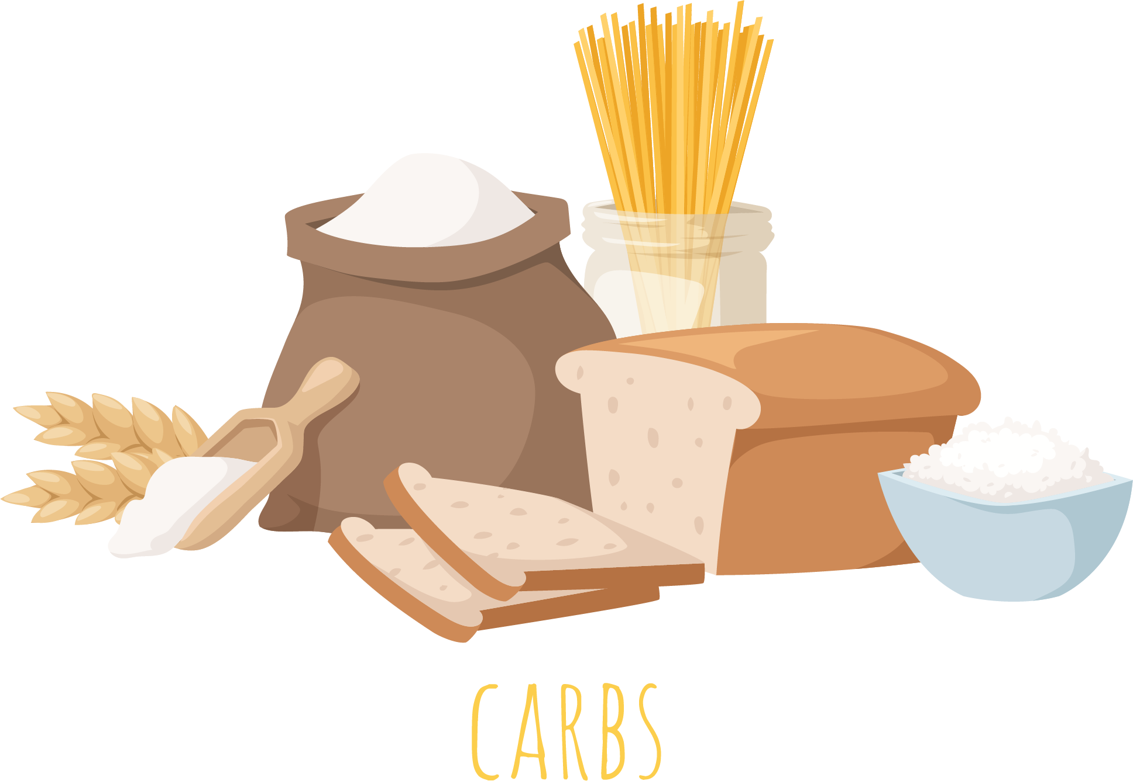
3 Major Nutrients
Carbohydrates
Your body’s main source of energy
Notes:
Going through this presentation you will explore why each of these nutrients are vital for achieving optimal performance and provide you with suggestions about how to ensure your body is getting what it needs.
There are so many ways you can incorporate these three major nutrients – carbohydrates, proteins, and fats into your diet. Take time to explore what nutrients make up your favorite foods or meals so you can incorporate them appropriately into a performance-based diet!
Let’s first look at Carbohydrates. This nutrient is the body’s main source of energy. What are some examples of carbs?
Some examples of carbs include: cereal, pasta, rice, vegetables, and whole/dried fruits.

Slide 9
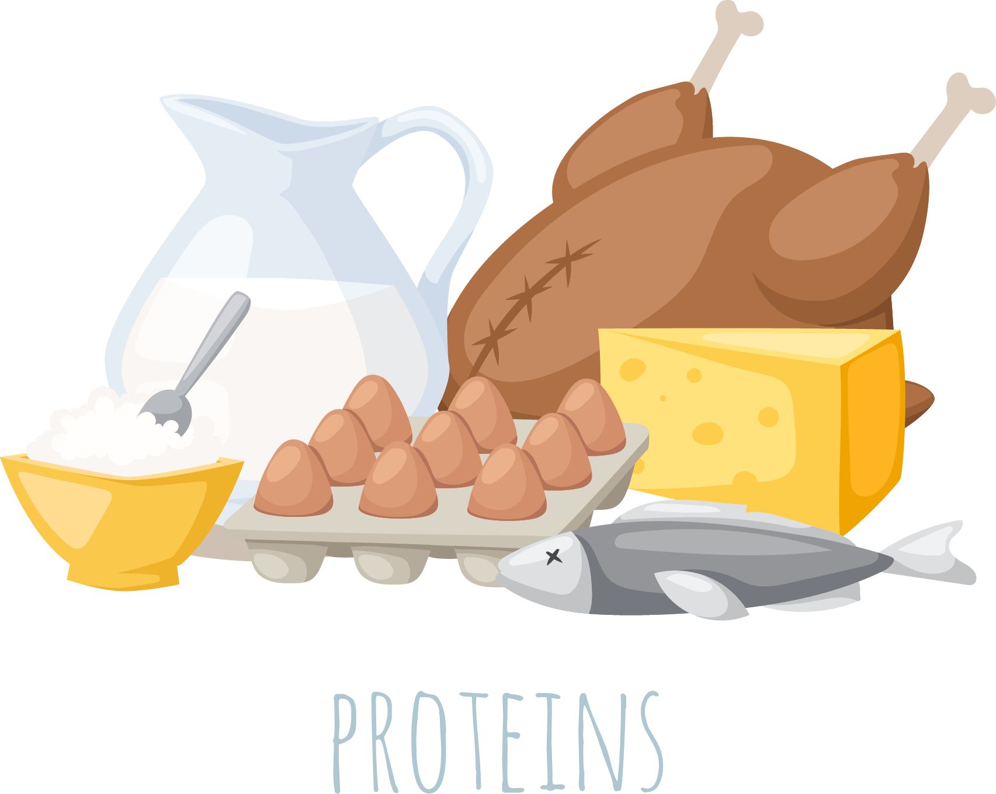
3 Major Nutrients
Proteins
The building blocks of your body
Notes:
Proteins are the building blocks of your body. What do you think are examples of proteins?
You’ll want to incorporate foods such as eggs, fish, poultry, beef, soy, nuts/beans, and dairy into your diet.

Slide 10
3 Major Nutrients
Fats
The body’s main form of stored energy
Notes:
Lastly, fats are the body’s main form of stored energy. What are some examples of fats?
Foods like avocado, oils, seeds, cheese, and butter are some examples of healthy fats.
Please recognize that some of the examples listed within these 3 major nutrients may contain a combination of carbs, proteins, and fats.

Slide 11
Notes:
When it comes to nutrition, we know there are instances where we want to indulge at a birthday party or go out for ice cream with friends. What we encourage is if 80% of the time your are choosing performance enhancing, nutrient rich food options, that is great! The other 20% of the time enjoy your ice cream, pizza party, or other treats that are right for you!
Striving for the perfect diet has the potential to increase anxiety and worsen your mood and mindset. The 80/20 rule can help you find a sustainable approach to your nutrition choices!
So how do you know what that 80% should be filled with? Let’s talk about it!

Slide 12
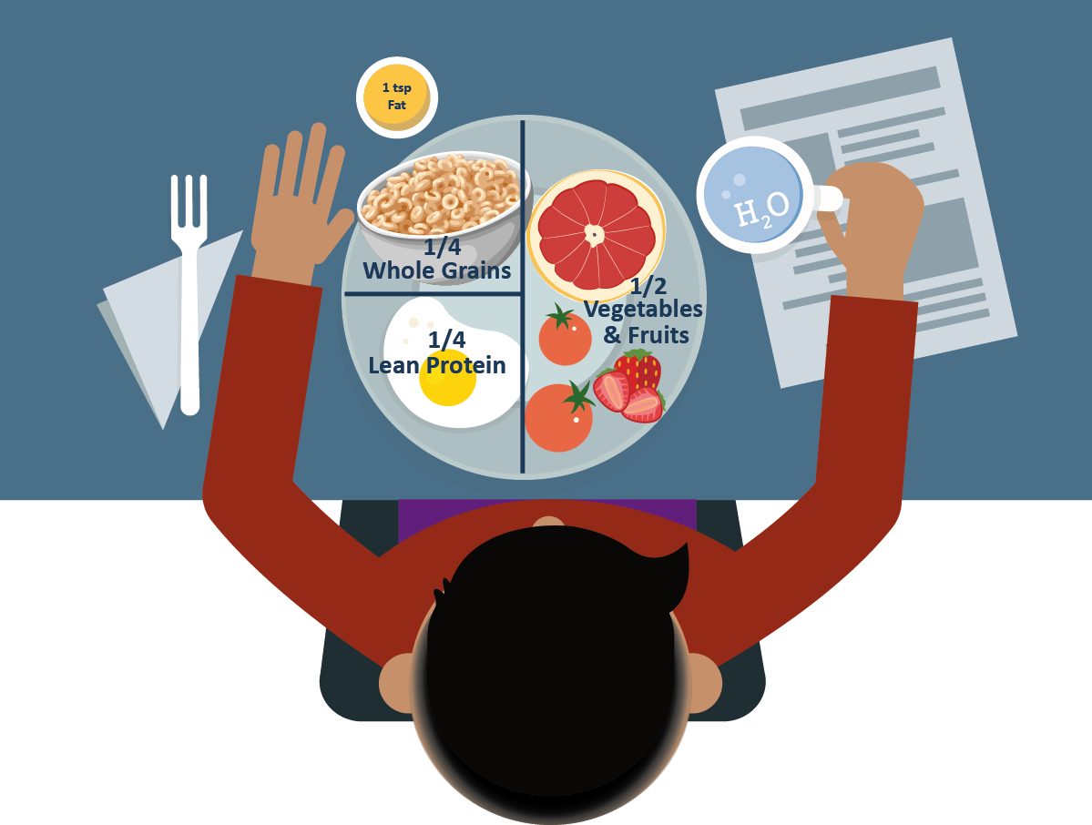
Light Plate Day
Notes:
Having a light plate day may mean you are experiencing anywhere from 0-60 minutes of low activity. During a lower activity day, you may experience these types of bodily reactions:
Breathing may be slightly increased from your resting state
You develop a light sweat during an activity
You can carry on a conversation during the activity
The plates shared in this PowerPoint are solely guidelines and individual nutrition needs will vary with growth, types of exercise, and intensity.
For light plate days, focus on having:
¼ of your plate containing whole grains (brown rice, popcorn, oatmeal, whole-wheat bread, pasta, or crackers)
½ of your plate containing vegetables and fruits (carrots, berries, oranges, grapes, banana, cucumber, broccoli, apple, etc.)
¼ of your plate containing lean protein (eggs, fish, yogurt, chicken, beans, turkey, cottage cheese, tofu, lean beef,
Around 1 tsp of fats and of course a large glass of water!

Slide 13
Moderate Plate Day
Notes:
A moderate plate day could be a day when you may have anywhere from 60-90 minutes of moderate to vigorous activity.
During a moderate activity day you may experience some or all of the following:
Your breathing quickens but you are not completely out of breath
You develop a sweat during the activity
You can carry on a conversation, but would have trouble singing it
For moderate plate days, focus on incorporating:
3/8 of your plate to contain whole grains
3/8 of your plate to contain vegetables and fruits
¼ of your plate to contain lean protein
Around 1 teaspoon of fats and of course a large glass of water!

Slide 14
Hard Plate Day
Notes:
On a hard plate day, you may have 90+ minutes of vigorous activity like a sports tournament, game, or large event or performance.
During a hard activity day, you may experience some or all of the following:
Breathing is deep and rapid
You may develop a significant sweat shortly into the activity
You can’t say but more than a few words without pausing and taking a breath
For hard plate days, consider using this plate as a guideline and incorporating:
½ of your plate to include whole grains
¼ of your plate to include vegetables and fruits
¼ of your plate to include lean proteins
Around 2 teaspoons of fats and of course a large glass of - you guessed it.. Water!

Slide 15
Activity: Creating Your Own Plate
Notes:
Let’s take a moment to create our own plates for an entire week of school!
You each will receive a worksheet and use this website for this activity for ideas: https://www.choosemyplate.gov/myplatekitchen
I’d like for you for each day to decide on a recipe or food choices for breakfast, lunch, and dinner as well as one snack for each day for 5 days! Think about the food items you like to eat, incorporating various nutrition sources like carbs, proteins, and fats as well as what kind of activity you may be doing that day and what kind of plate your day falls under.
I’ll show you a brief example on the next slide.

Slide 16
Example: Creating My Plate
Monday: Light Plate Day
Breakfast: 1 apple cut into wedges with peanut butter, 1 slice of whole wheat toast, and 1 scrambled egg
Lunch: Turkey sandwich (turkey, lettuce, tomato, mayo, 2 slices of whole wheat bread), baby carrots, and strawberries
Snack: Goldfish and a cutie orange
Dinner: Brown rice, chicken, and sautéed vegetables

Slide 17
How Does Nutrition Connect to Other Science Modules?
Learning how sleep, nutrition, mood and mindset, and chemical health are all interconnected
Notes:
Mood and Mindset, Chemical Health, Sleep, and Nutrition are all connected! The choices you make in one area of your life are actively impacting the choices you make in others. Here are a few ways that your nutrition choices interact with the other modules:

Slide 18
Nutrition and Sleep
Eating heavy food after 8PM may contribute to difficulty falling asleep and an unrestful nights sleep. If you feel hunger cues later at night, choosing a carb and protein combination such as fruit and nuts or yogurt may help!
Notes:
Read slide

Slide 19
Nutrition and Chemical Health
Substance use can impact your body’s ability to successfully absorb vitamins and minerals, maintain glucose levels, and process optimal sources of energy from healthy nutrients in food.
Notes:
Read slide

Slide 20
Nutrition and Mood and Mindset
Thinking about the future or something you are grateful for before choosing what to eat can increase the chance that you make a healthy food choice. The nutritional choices we make can equally impact how we feel.
Notes:
Read slide

Slide 21
Culture and Accountability
Building Accountability and Conversation Tools
Notes:
Building accountability:
Making healthy food choices is not always easy when we are surrounded by fast food restaurants, processed foods at the grocery store, or junk food options in vending machines. This is why it is even more important to work with your peers to hold each other accountable to pick better food and drink options and work hard to teach others how they can make better choices.

Slide 22
Culture and Accountability
To create a consistent culture and message people must:
Personal Accountability: First, make choices that will benefit your own personal outcome.
Group Accountability: Second, remind your friends that what foods and drinks they put into their body will impact their performance too.
Leadership Accountability: Third, help create an environment where healthy food and drink choices are easier.
Notes:
To create a consistent culture and message people must:
Personal Accountability: First, make choices that will benefit your own personal outcome. Remind yourself that the nutrition choices you make will keep your body healthy and help you perform at your best.
Example: Choose to order grilled chicken instead of pizza, or bring your lunch from home instead of buying fast food.
Group Accountability: Second, remind your friends that what food and drinks they put into their body will impact their performance too. Encourage that you all hold each other accountable for making healthy snack and meal options throughout the day when you are together.
Example: Have healthy group snacks or meals together. If you see someone eating things like candy bars before practice, suggest that might not be the best fuel for them and offer an alternative
Leadership Accountability: Third, help create an environment where healthy food and drink choices are easier. Advocate for healthier food options in the lunch line and vending machines or spend time teaching others the importance of making positive nutritional choices to benefit their performance. Keeping healthy expectations for yourself and others makes a difference!
Example: Advocate for healthy vending machines, after-school brown bag lunch program, or pro-healthy message signage

Slide 23
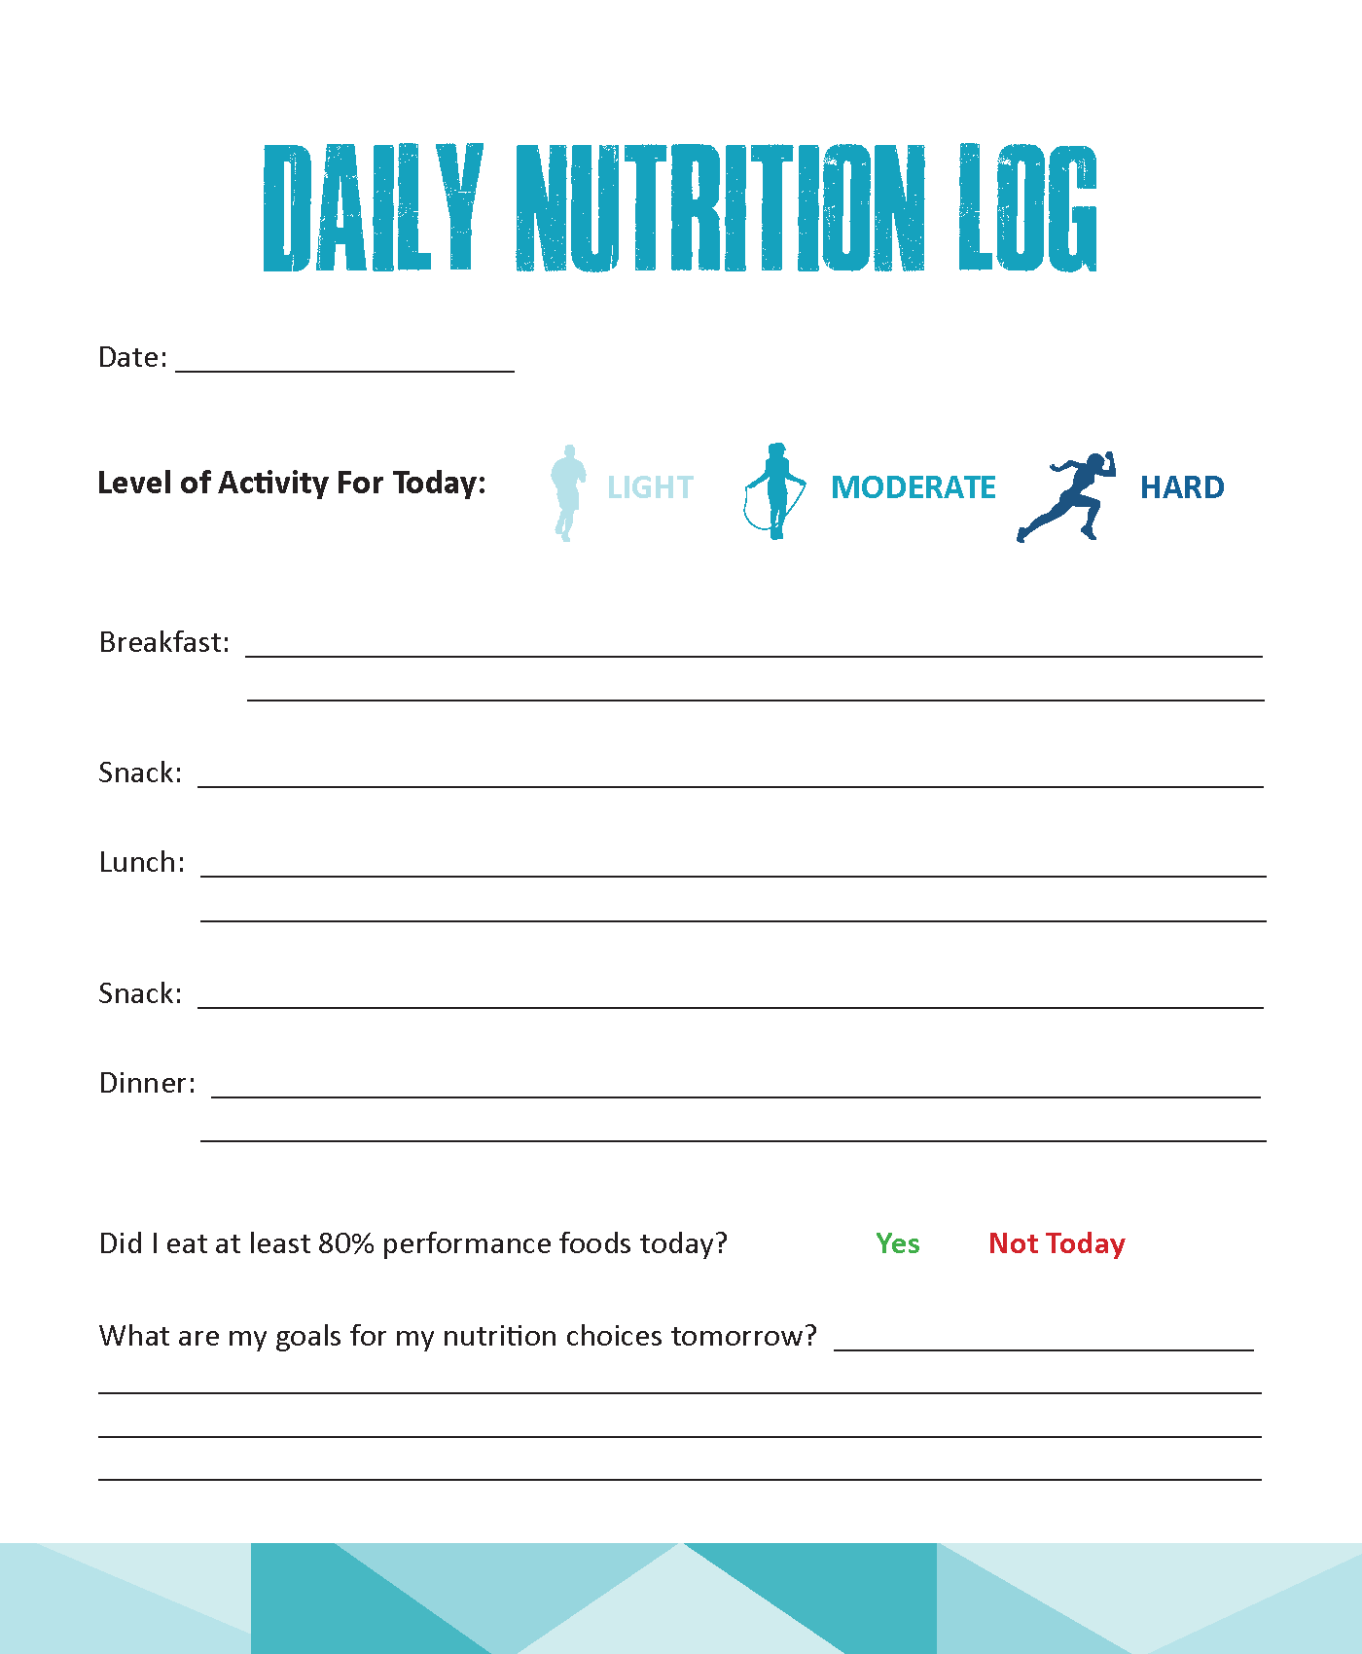
Daily Nutrition Log
To help you track your nutrition habits and factors that may contribute to it, use the Daily Nutrition Log handout to keep track of your food and beverage choices each day.
Notes:
Use the Daily Nutrition Log handout to track your performance level for that day, as well as what you ate to ensure your food and beverage choices are at least 80% performance based.
Suggestion: if you wanted to, you could hand each participant two copies – one that they can do in the moment as a reflection of the prior day, and one that they can take home with them for future days.
This daily nutrition log can also be found in our Nutrition Guide.

Slide 24
Questions?

Slide 25
Thank you!

