Slide 1
Sleep
Illinois Human Performance Project
Notes:
Welcome to today’s training on Sleep! This training follows the sleep guide produced by the Illinois Human Performance Project.

Slide 2
Objectives:
After this training, participants will be able to:
Explain the importance of sleep
Understand the impact sleep has on our bodies and well-being
Develop accountability through themselves and their peers
List examples of ways to optimize sleep
Explain the connection of sleep with other science modules discussed through the Human Performance Project
Notes:
During this training, we will take the opportunity to learn more about the importance of sleep, while providing interactive activities to understand how well we are sleeping and find ways to improve our sleep patterns.

Slide 3
Why Should We Talk About Sleep?
The Importance of a Good Night’s Rest
Notes:
On a piece of flip-chart paper, write down thoughts and ideas of participants as to why they think students should talk about sleep.
If they are struggling with coming up with ideas, mention the following suggestions:
To maintain positive lifestyles and well-being
To recognize the standards that coaches, teachers, and parents place on young people
To educate others about the positive impact of sleep and negative impact of a lack of sleep
It’s value to better grades, nutrition, enhance mood and mindset

Slide 4
Why Talking is Important!
Sleep
Influences your ability to perform in all areas of waking life
Increases your overall well-being and longevity of life
Interconnected with so many other components of your life including mood and mindset, nutrition, and chemical health
The majority of people do not reach the required amount of sleep in a night (WE NEED MORE SLEEP!)
Notes:
It’s important to recognize how large a factor sleep plays in our everyday lives. The amount of time we allow our bodies to rest and recover at night directly impacts our ability to perform in the following days.
If we do not get enough sleep, we are more prone:
Be overweight.
Not engage in as much daily physical activity.
Suffer from symptoms of depression.
Engage in unhealthy risk behaviors such as drinking, smoking tobacco, and using illicit drugs.
Perform poorly in school.
Resources:
https://www.cdc.gov/features/school-start-times/index.html

Slide 5
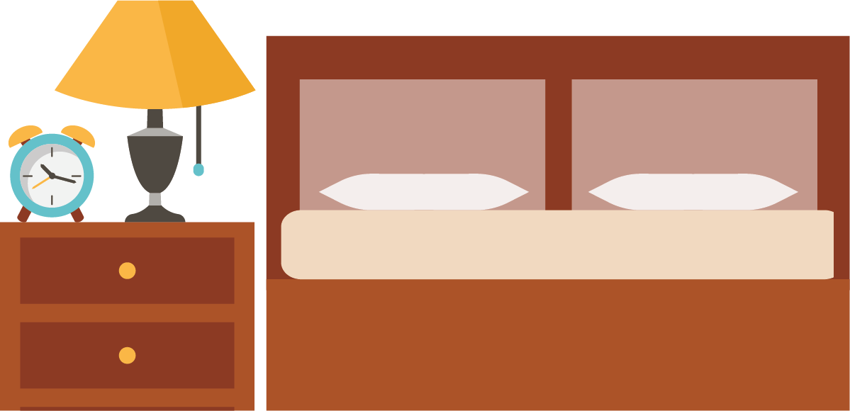
Are you getting enough sleep?
Activity:
Notes:
Instructions for sleep activity:
1.) Get everyone in the room to stand up and create a line.
2.) Tell everyone in the line to organize themselves based on the amount of sleep that they had the previous night – starting with the least amount of sleep at the front of the line and the most amount of sleep at the back of the line.
3.) Explain the affect that a lack of sleep will have on the body for those standing in the line with less than 5 hours
For those standing in the line at 6-7 hours of sleep – explain how even just a reduced amount of sleep can affect your ability to recover in the late stages of sleep in the morning
For those 8 or more – explain how this can set you up for success, but it is important to try to hit this number consistently each night
4.) You can also get those in the line to organize themselves by the time that they went to sleep. Explain how certain sleep-wake times align with our circadian rhythms.
(Pass out sleep journal worksheet for each person to write out and track their sleep each night for a week)

Slide 6
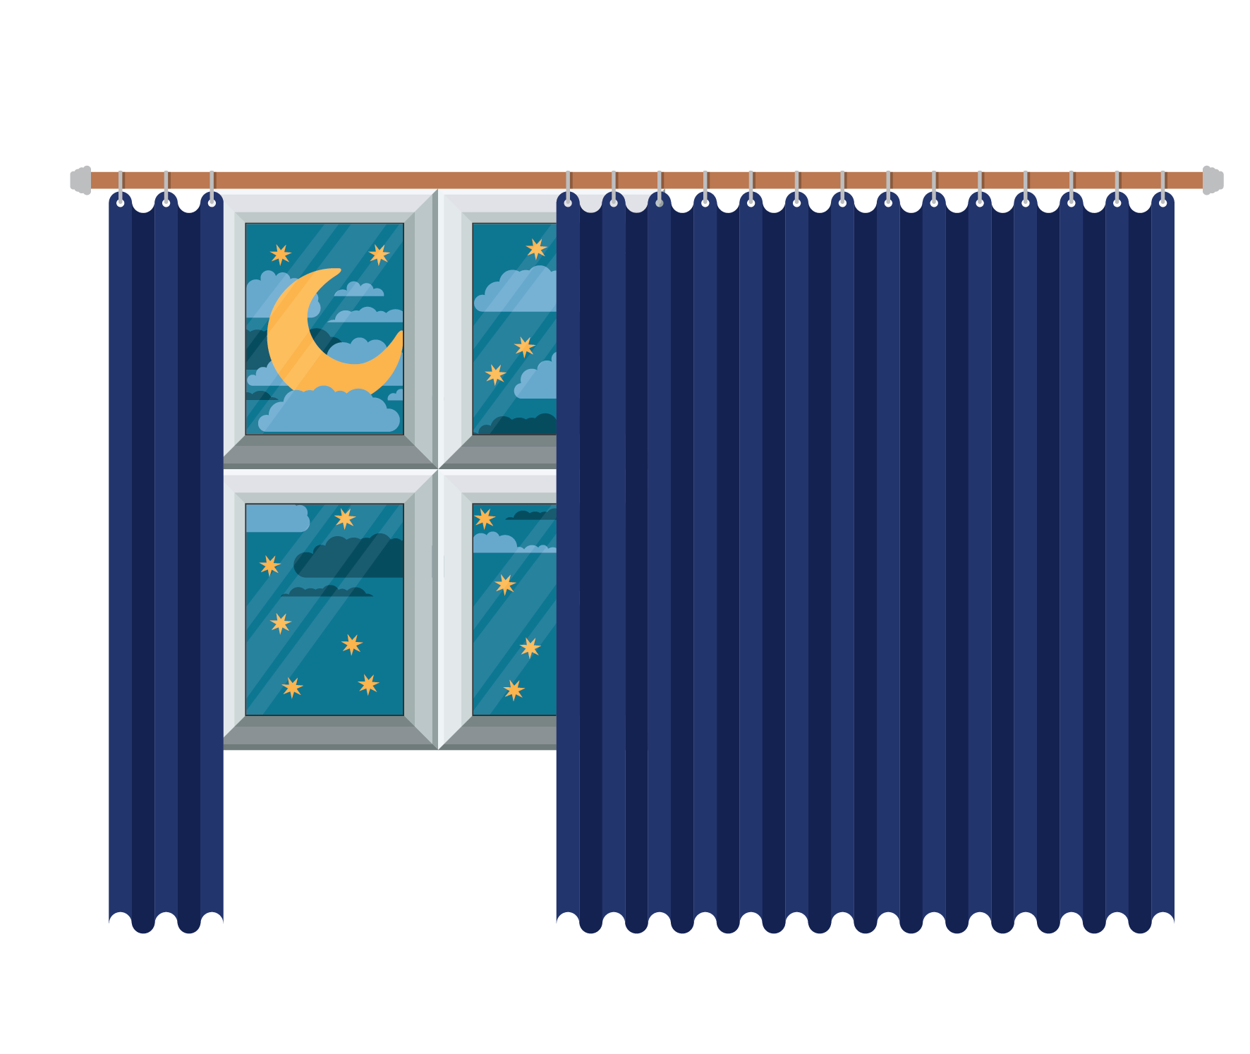
8-10 hours
Notes:
Age Group Recommended Hours of Sleep Per Day
Newborn 0–3 months: 14–17 hours
Infant 4–12 months: 12–16 hours per 24 hours (including naps)
Toddler 1–2 years: 11–14 hours per 24 hours (including naps)
Preschool 3–5 years: 10–13 hours per 24 hours (including naps)
School Age 6–12 years: 9–12 hours per 24 hours
Teen 13–18 years: 8–10 hours per 24 hours
Adult 18–60 years: 7 or more hours per night
61–64 years: 7–9 hours
65 years and older: 7-8 hours
References:
https://www.cdc.gov/sleep/about_sleep/how_much_sleep.html

Slide 7
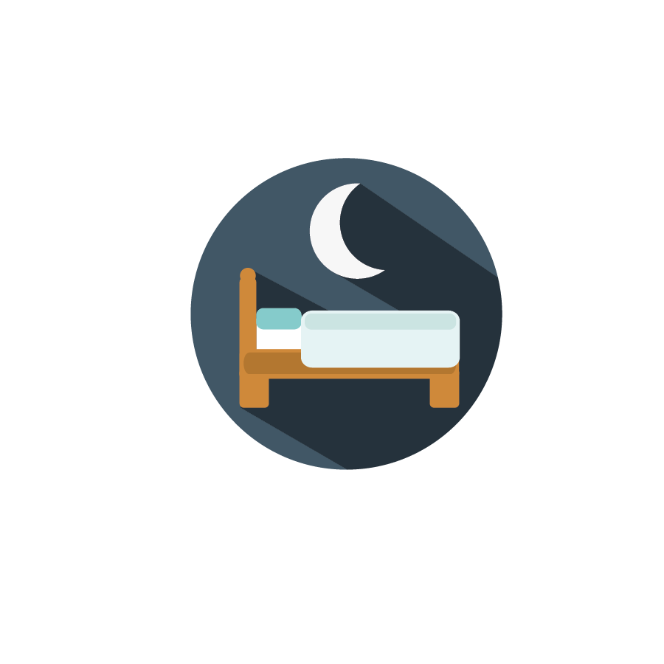
Sleep Stages
Stage 1 (NREM 1)
Transition from wakefulness to sleep
Relatively light sleep
Muscle activity slows down
Stage 2 (NREM 2)
REM Sleep
Brain waves speed up
Majority of dreams occur
Heart rate decreases
Breathing pattern and heart rate slows
Body temperature decreases
Eye movements stop
Stage 3 (NREM 3)
Deep sleep begins
Brain generates delta waves
Muscle activity is limited
Notes:
There are two basic types of sleep: 1. REM (Rapid Eye Movement) Sleep 2. Non-REM (three stages)
You cycle through all stages of non-REM and REM sleep (4-6) times during a typical night, with increasingly longer, deeper REM periods occurring towards morning.
Stage 1: This short period may last several minutes. Your brain waves begin to slow from their daytime wakefulness patterns.
Stage 2: You spend more of your repeated sleep cycles in stage 2 than in any other sleep stages.
Stage 3: This is the period of deep sleep that you need to feel refreshed in the morning. Your heartbeat and breathing slow to their lowest levels during sleep. Your muscles are relaxed and it may be difficult to awaken you. This stage occurs in longer periods during the first half of the night.
REM: This stage first occurs about 90 minutes after falling asleep. Your eyes move rapidly from side to side (behind closed eyelids). Your breathing becomes faster and irregular, and your heart rate and blood pressure increase to near waking levels. Most of your dreaming occurs in REM sleep, although some can occur in NREM. Your arm and leg muscles are temporarily paralyzed, which prevents you from acting out your dreams.
Resources:
https://www.ninds.nih.gov/Disorders/Patient-Caregiver-Education/Understanding-Sleep
http://healthysleep.med.harvard.edu/healthy/matters

Slide 8
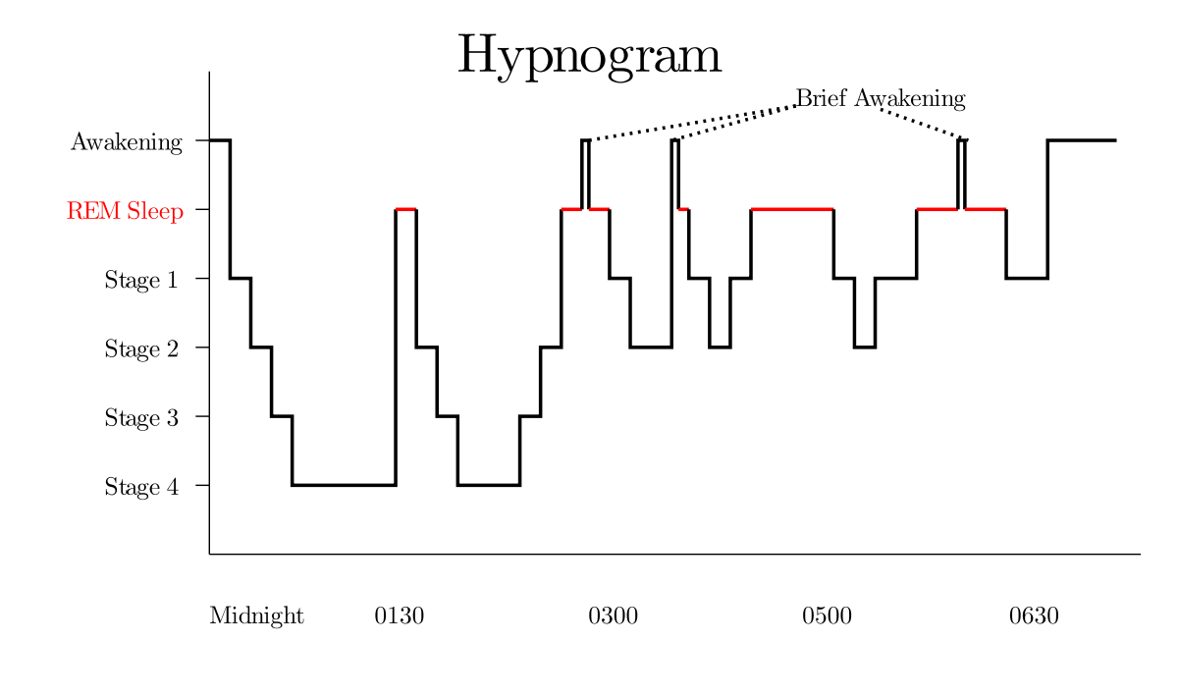
Notes:
A hypnogram is a graph that represents the stages of sleep as a function of time. It was developed as an easy way to present the recordings of the brain wave activity from an electroencephalogram (EEG) during a period of sleep.
https://en.wikipedia.org/wiki/Rapid_eye_movement_sleep

Slide 9
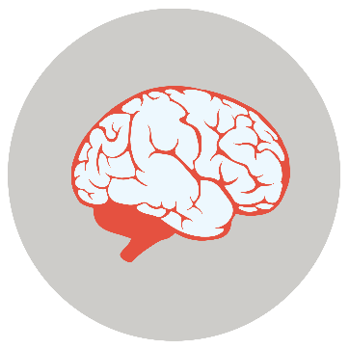
The Power of Sleep
Maintains immune system function and health
Increases brain health, cognitive function, and CNS readiness
Helps you recover from daily activities
Improves overall sense of well-being!
Notes:
Immune System: Chronic sleep deprivation suppresses immune system while getting adequate sleep can boost the immune system
Sleep deprivation can lead to increase in the stress hormone ‘cortisol’, which can weaken the immune system and make you more prone to catching an illness.
Brain Health and Cognitive Function: More sleep increases problem solving ability, creativity, and learning ability while strengthening awareness, enhancing memory, and improving attention.
Studies have shown creative problem solving to be enhanced by REM sleep.
REM sleep helps achieve solutions by stimulating associative networks, allowing the brain to make new and useful associations between unrelated tasks
Naps can help memory and recollection in tasks
Recovery from Daily Activities: Sleep recharges your heart and cardiovascular system for the next day. During sleep, growth hormones are also released to stimulate muscle growth, repair, and overall recovery. Chronic lack of sleep is also associated with increased injury risk among adolescent athletes. Studies have shown that athletes who sleep eight hours or more each night were 68 percent less likely to be injured than athletes who regularly slept less.
Overall Sense of Well-Being: We feel more alert, more energetic, happier, and better able to function following a good night of sleep.
Resources:
https://www.health.harvard.edu/staying-healthy/how-to-boost-your-immune-system
https://www.sciencedaily.com/releases/2017/01/170127113010.htm
https://www.aap.org/en-us/about-the-aap/aap-press-room/pages/Lack-of-Sleep-Tied-to-Teen-Sports-Injuries.aspx
https://www.sciencedaily.com/releases/2009/06/090608182421.htm

Slide 10
Sleep and learning
“Sleep on it”
People have shown to learn tasks better if they are well rested
They can also better remember what they learned if they get a good night’s sleep
Lack of sleep causes thinking processes to slow down
Lack of sleep leads to faulty decision making and more risk taking
Notes:
Resources:
https://newsinhealth.nih.gov/2013/04/sleep-it
http://www.educationalneuroscience.org.uk/resources/neuromyth-or-neurofact/well-rested-children-do-better-at-school/
https://www.health.harvard.edu/blog/sleep-helps-learning-memory-201202154265
https://www.acsh.org/news/2017/11/08/sleep-loss-causes-brain-activity-slow-study-shows-12118
http://healthysleep.med.harvard.edu/healthy/matters/consequences/sleep-performance-and-public-safety

Slide 11
Sleep and all-nighters
Students who pull all-nighters have greater difficulty concentrating and making decisions
A lack of sleep can disrupt your ability to process memories and things you’ve studied for the next day
Trying to catch up on sleep on the weekends is often not enough to compensate for extreme lack of sleep during the week
Notes:
Getting an adequate amount of sleep gives your body the chance to process new information so you remember it the next day on your test. Many students think that pulling all-nighters will help them pass a test, but this is often not the case.
Students who pull all-nighters have greater difficulty concentrating and making decisions, as well as delayed reaction times, compared with classmates who get a full night’s sleep. A lack of sleep can worsen your memory, which means that all that time spent reviewing flash cards until 5:00 am could end up being a waste of time.
People may also sacrifice a good amount of sleep during the week, thinking that they can make it up by sleeping extra on the weekends. Research shows that it is very difficult to catch up on any sleep once it is repeatedly and chronically lost. The better option is to be organized, stick to a scheduled sleep routine, and make sleep a top priority!
Resources:
https://www.sleep.org/articles/all-nighters-and-health/
https://onlinelibrary.wiley.com/doi/abs/10.1046/j.1365-2869.2003.00351.x
https://www.everydayhealth.com/sleep/study-reveals-why-all-nighters-may-dangerous-your-health/
http://healthysleep.med.harvard.edu/healthy/matters/benefits-of-sleep/learning-memory
https://sleep.med.harvard.edu/news/337/A+Catch+Up+Night+Of+Sleep+Not+Enough+to+Compensate

Slide 12
Sleep and driving ability
11.5x
Sleep Amount
Microsleep - a momentary lapse in concentration where there are sudden shifts between states of wakefulness and sleep
More than two million people fall asleep in the U.S. driving their motor vehicle
Increased Crash Risk
4.3x
1.9x
1.3x
<4 Hr
4-5 Hr
5-6 Hr
6-7 Hr
<4 Hr
4-5 Hr
5-6 Hr
6-7 Hr
Compared to drivers who had slept for at least 7 hours in the past 24 hours, drivers who reported they had slept:
Notes:
Sleep can even impact our ability to operate a vehicle the following day. A lack of sleep the night before can be extremely dangerous if you are planning on driving.
The estimated crash risk associated with driving after only 4-5 hours of sleep compared with 7 hours or more is similar to the National Highway Traffic Safety Administration’s estimates of the crash risk associated with driving with a blood alcohol concentration (BAC) equal to or slightly over the legal limit for alcohol in the US (0.08), and the crash risk associated with having slept less than 4 hours of sleep is comparable to the crash risk associated with a BAC of roughly 0.12-0.15
Resources:
https://www.nhtsa.gov/risky-driving/drowsy-driving
https://aaafoundation.org/acute-sleep-deprivation-risk-motor-vehicle-crash-involvement/

Slide 13
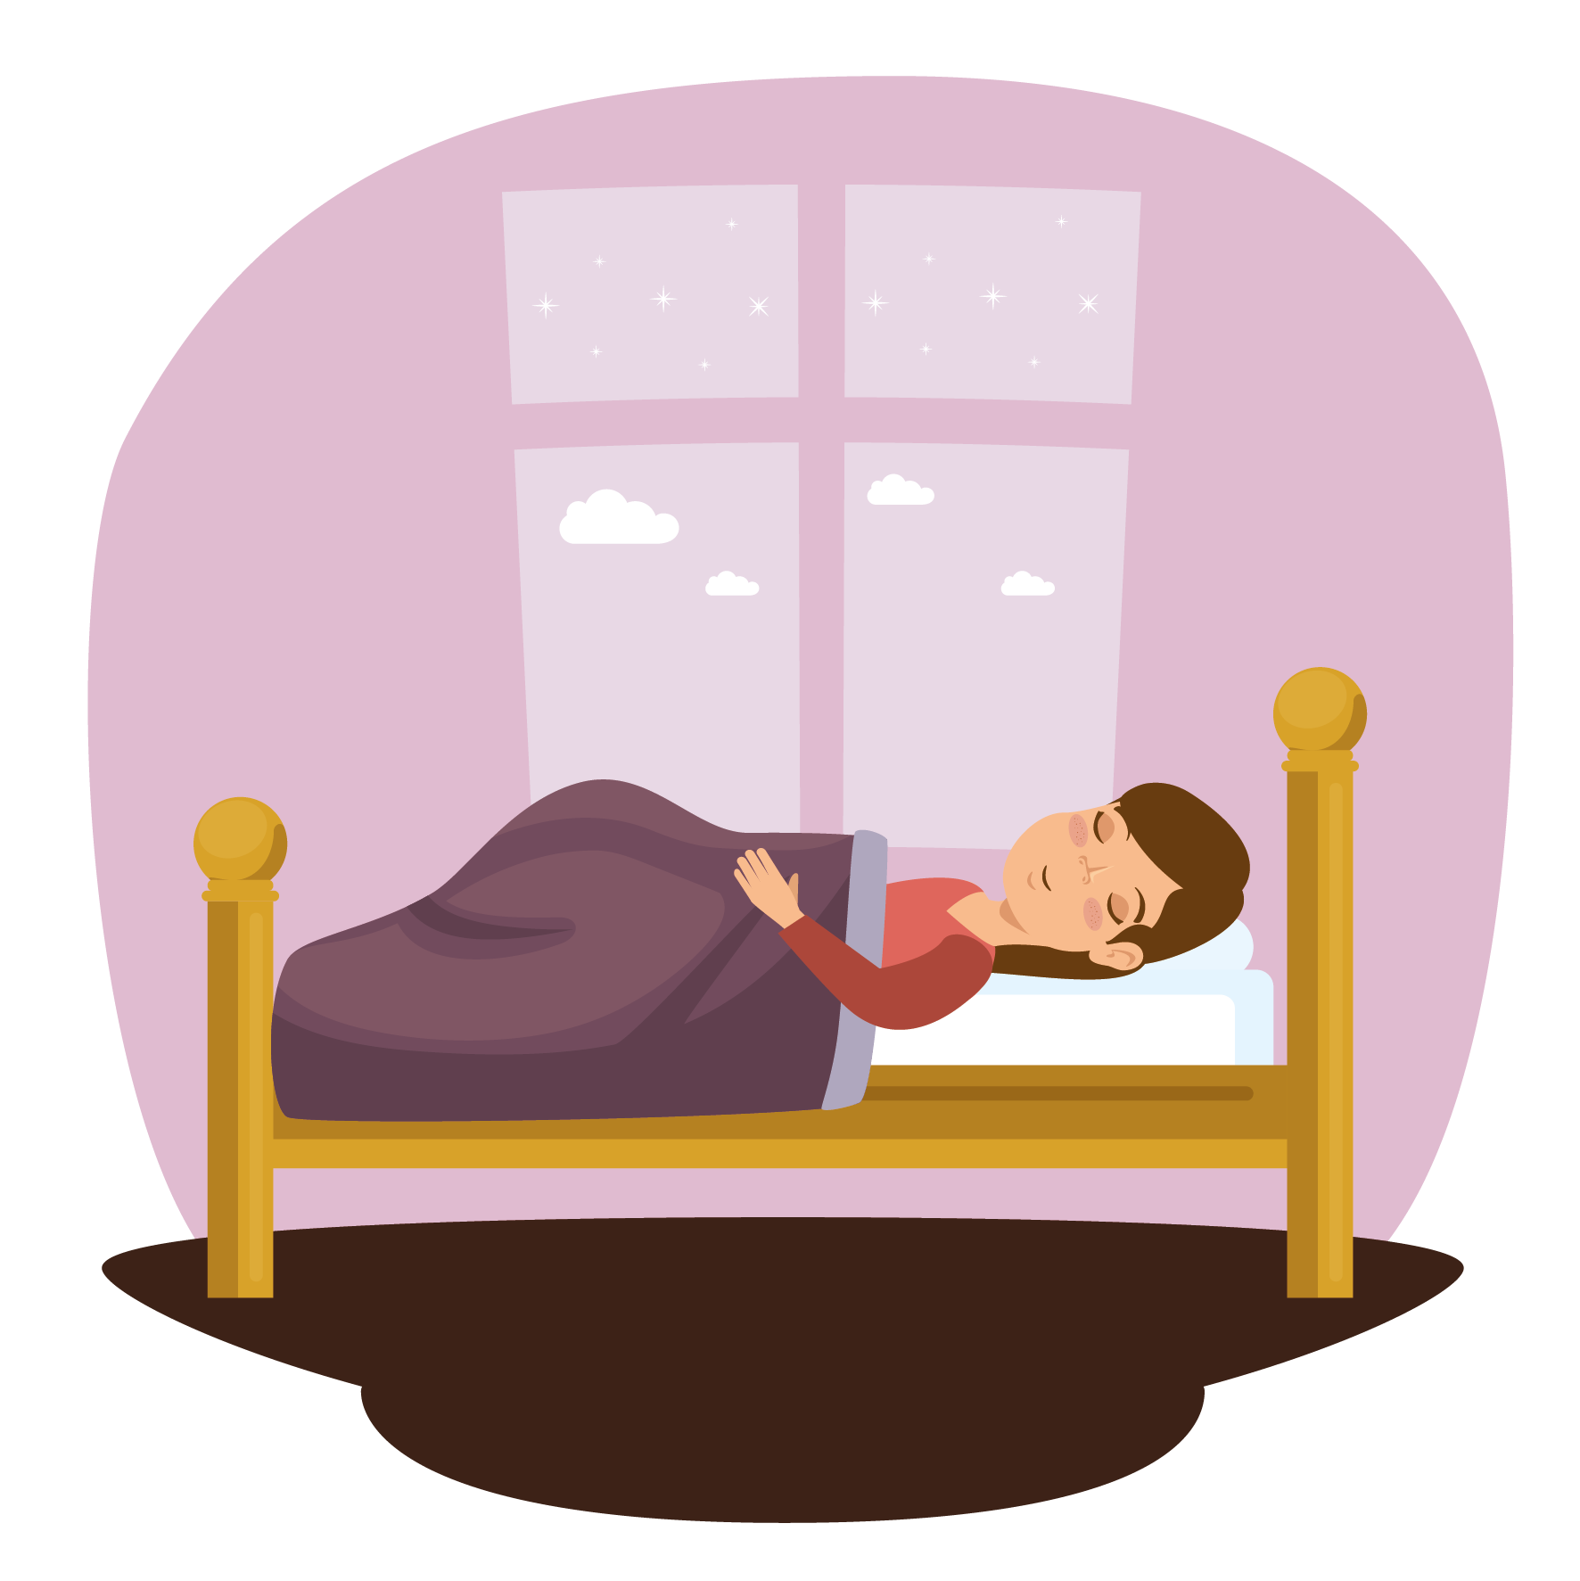
How Does Sleep Connect to Other Science Modules?
Learning how sleep, nutrition, mood and mindset, and chemical health are all interconnected
Notes:
Sleep, Mood and Mindset, Chemical Health, and Nutrition are all important in their own ways, but are all connected! The choices you make in one area of your life are actively impacting the choices you make in others. Here are a few ways that your sleep can interact with the other modules:

Slide 14
Sleep: Mood and Mindset
Sleep and mood are closely connected: poor or inadequate sleep can cause irritability and stress, while healthy sleep can enhance your well-being
Notes:
Researchers found that subjects who were limited to only 4.5 hours of sleep a night for one week reported feeling more stressed, angry, sad, and mentally exhausted. When the subjects resumed normal sleep, they reported a dramatic improvement in mood
Chronic insomnia may increase an individual's risk of developing a mood disorder, such as depression or anxiety. In one major study of 10,000 adults, people with insomnia were five times more likely to develop depression
Resources:
Dinges, D. et al., Cumulative Sleepiness, Mood Disturbance, and Psychomotor Vigilance Decrements During a Week of Sleep Restricted to 4 – 5 Hours Per Night, Sleep. 1997 Apr; 20 (4): 267–277.
http://healthysleep.med.harvard.edu/need-sleep/whats-in-it-for-you/mood

Slide 15
Sleep: Chemical Health
Stimulants such as caffeine in energy drinks and coffee and depressants such as alcohol can negatively impact the quantity and quality of your sleep.
Alcohol before bed can:
Disrupt your circadian rhythms
Block REM sleep
Aggravate breathing problems
Lead to extra bathroom trips
Caffeine before bed can:
Disrupt your circadian rhythms
Reduce total sleep time
Notes:
Caffeine: Unlike food and sleep, caffeine cannot replenish energy or prevent emotional fatigue.
Adults should limit caffeine consumption to no more than about 200 mg to 300 mg per day, adolescents to 100 mg, and younger children to none.
It is best to avoid caffeine in the late afternoon and evening
Alcohol: Studies show that a moderate dose of alcohol consumed as much as 6 hours before bedtime can increase wakefulness during the second half of sleep. Alcohol use can limit your ability to reach the restorative parts of sleep. It is best to avoid this substance completely.
Resources:
https://uhs.umich.edu/caffeine
http://sleepeducation.org/news/2013/08/01/sleep-and-caffeine
http://jcsm.aasm.org/viewabstract.aspx?pid=29198
http://stm.sciencemag.org/content/7/305/305ra146
https://pubs.niaaa.nih.gov/publications/aa41.htm
https://sleepfoundation.org/sleep-topics/how-alcohol-affects-sleep

Slide 16
Sleep: Nutrition
During sleep, the body regulates the production of your “hunger hormones”.
People who report an average total sleep time of 5 hours a night are much more likely to become obese, compared with people who sleep 7–8 hours a night.
Notes:
Studies find that the less people sleep, the more likely they are to be overweight or obese and prefer eating foods that are higher in calories and carbohydrates.
A number of hormones released during sleep also control the body’s use of energy: Leptin: appetite suppressor, Ghrelin: appetite stimulant.
Resources:
https://www.nhlbi.nih.gov/files/docs/public/sleep/healthy_sleep_atglance.pdf
https://www.scientificamerican.com/article/sleep-deprivation-tied-to/

Slide 17
What is Bluelight?
Blue light is the color in the “visible light spectrum” that can be seen by the human eye. It can affect the levels of the sleep inducing hormone ‘melatonin’ and affect our ability to fall asleep at night.
Artificial sources of blue light include electronic devices such as cell phones and laptop computers, as well as energy-efficient florescent bulbs and LED lights.
Notes:
To reduce your blue light exposure, turn off your device before bed or leave it in another room. You can also dim the brightness on your device to limit your exposure to the bright light.
https://www.scientificamerican.com/article/q-a-why-is-blue-light-before-bedtime-bad-for-sleep/ http://www.bluelightexposed.com/

Slide 18
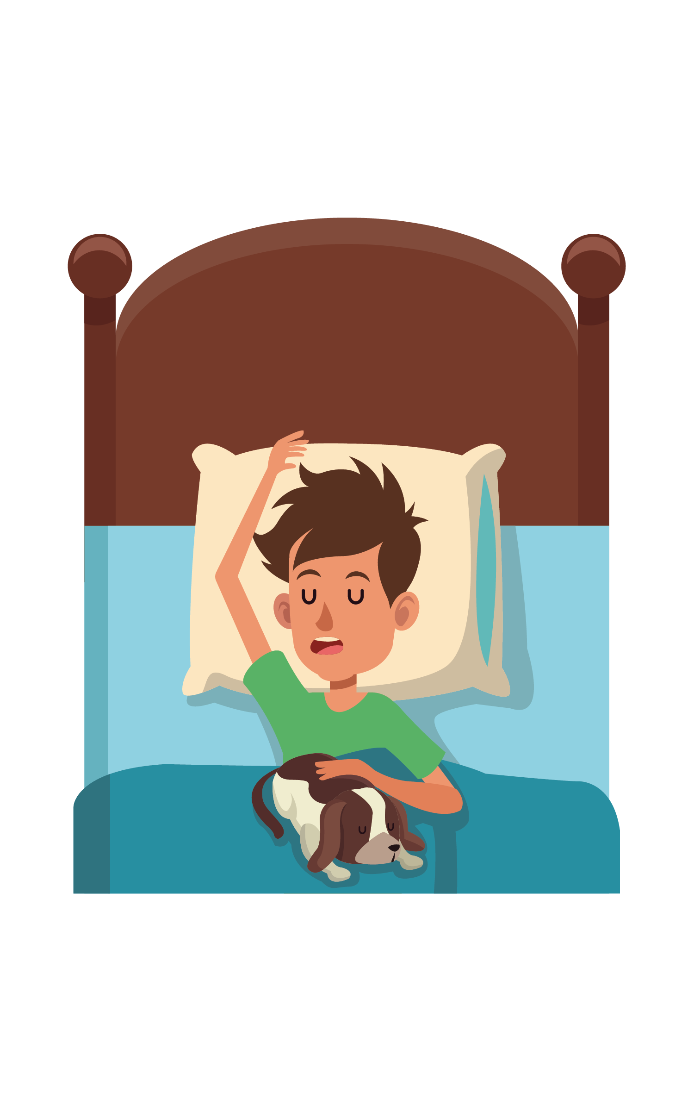
Tips for Great Sleep
Ways to prep yourself during the day for a good night’s sleep
1. Have sufficient sunlight exposure
2. No naps after 3 pm
3. Don’t exercise late in the day
Notes:
Have sufficient sunlight exposure: Daylight is key to regulating daily sleep patterns. Try to get outside in natural sunlight for at least 30 minutes each day. If possible, wake up with the sun or use very bright lights in the morning. Sleep experts recommend that, if you have problems falling asleep, you should get an hour of exposure to morning sunlight and turn down the lights before bedtime.
Don't take naps after 3 p.m.: Naps can help make up for lost sleep, but late afternoon naps can make it harder to fall asleep at night.
Exercise is great, but not too late in the day: Try to exercise at least 30 minutes on most days but not later than 2—3 hours before your bedtime.
https://medlineplus.gov/magazine/issues/summer12/articles/summer12pg20.html

Slide 19
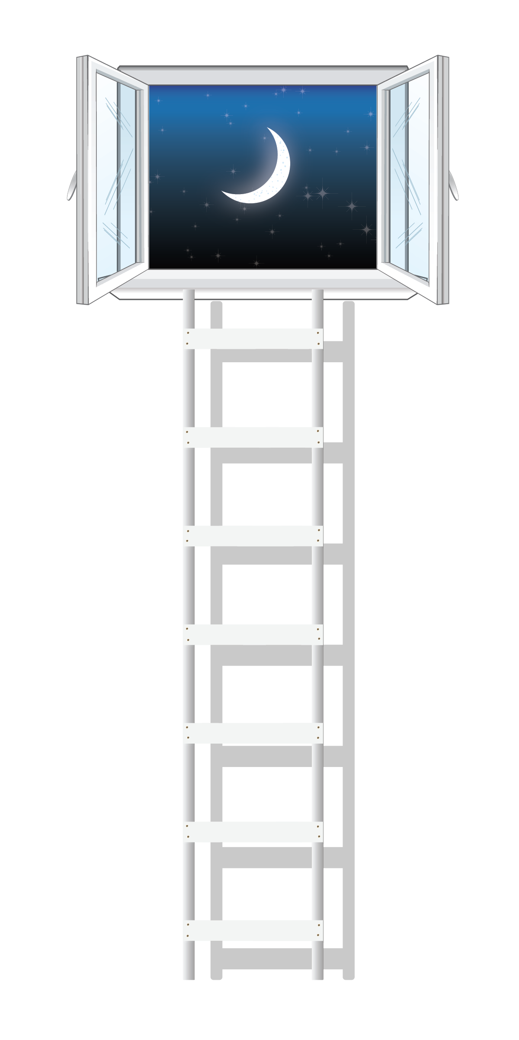
Tips for Great Sleep
Ways to prep yourself at night for a good night’s sleep
5. Stick to a consistent sleep schedule
6. Relax before bed
7. Don’t lie in bed awake
8. Have a good sleep environment
Notes:
Stick to a sleep schedule: Go to bed and wake up at the same time each day. As creatures of habit, people have a hard time adjusting to changes in sleep patterns. Sleeping later on weekends won't fully make up for a lack of sleep during the week and will make it harder to wake up early on Monday morning.
Relax before bed: Don't overschedule your day so that no time is left for unwinding. A relaxing activity, such as reading or listening to music, should be part of your bedtime ritual.
Don't lie in bed awake: If you find yourself still awake after staying in bed for more than 20 minutes or if you are starting to feel anxious or worried, get up and do some relaxing activity until you feel sleepy. The anxiety of not being able to sleep can make it harder to fall asleep.
Have a good sleeping environment: Get rid of anything in your bedroom that might distract you from sleep, such as noises, bright lights, an uncomfortable bed, or warm temperatures. You sleep better if the temperature in the room is kept on the cool side. A TV, cell phone, or computer in the bedroom can be a distraction and deprive you of needed sleep. Having a comfortable mattress and pillow can help promote a good night's sleep. Individuals who have insomnia often watch the clock. Turn the clock's face out of view so you don't worry about the time while trying to fall asleep.
https://medlineplus.gov/magazine/issues/summer12/articles/summer12pg20.html

Slide 20
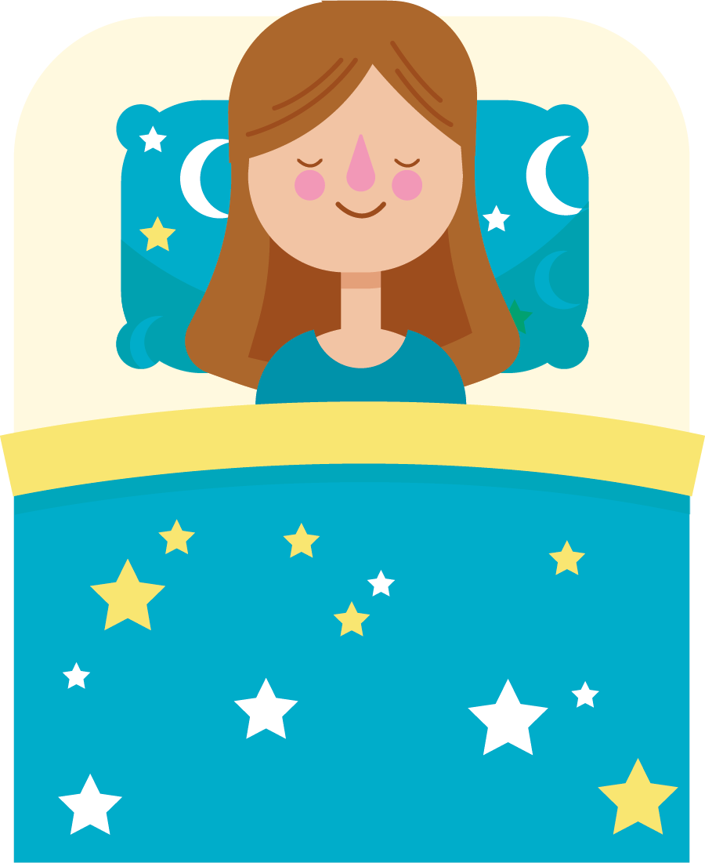
Tips for Great Sleep
Things to avoid for a good night’s sleep
9. Avoid Late Night Beverages and Meals
10. Avoid Medicines that Delay or Disrupt Sleep
(If possible – talk with doctor)
11. Avoid Caffeine and Nicotine
12. Avoid Alcoholic Drinks
Notes:
Avoid large meals and beverages late at night: A light snack is okay, but a large meal can cause indigestion that interferes with sleep. Drinking too many fluids at night can cause frequent awakenings to urinate.
If possible, avoid medicines that delay or disrupt your sleep: Some commonly prescribed heart, blood pressure, or asthma medications, as well as some over-the-counter and herbal remedies for coughs, colds, or allergies, can disrupt sleep patterns. If you have trouble sleeping, talk to your healthcare provider or pharmacist to see whether any drugs you're taking might be contributing to your insomnia and ask whether they can be taken at other times
Avoid caffeine and nicotine: Coffee, colas, certain teas, and chocolate contain the stimulant caffeine, and its effects can take as long as 8 hours to wear off fully. Therefore, a cup of coffee in the late afternoon can make it hard for you to fall asleep at night. Nicotine is also a stimulant, often causing smokers to sleep only very lightly. In addition, smokers often wake up too early in the morning because of nicotine withdrawal.
Avoid alcoholic drinks before bed: Having a "nightcap" or alcoholic beverage before sleep may help you relax, but heavy use robs you of deep sleep and REM sleep, keeping you in the lighter stages of sleep. Heavy alcohol ingestion also may contribute to impairment in breathing at night. You also tend to wake up in the middle of the night when the effects of the alcohol have worn off.
https://medlineplus.gov/magazine/issues/summer12/articles/summer12pg20.html

Slide 21
Culture and Accountability
Building Accountability and Conversation Tools
Notes:
Building accountability:
Many things might influence us to stay up late and skip sleep:
Friends, social interactions
Homework, studying, work
Electronic media: watching TV, cell phone use (social media), video games
When it comes to being healthy, we have to make sacrifices in other aspects of our life and align our priorities in a way that helps us achieve optimal performance.
There are only 24 hours in a day, but we must make time for 8 hours of sleep!
(Pass out handout on sleep tips)

Slide 22
Culture and Accountability
To create a consistent culture and message people must:
Personal Accountability: First, strive to have a positive and optimistic personal viewpoint on life, activities, and how you spend your time.
Group Accountability: Second, encourage others to live out an uplifting and supportive mindset to influence those around them.
Leadership Accountability: Third, show others how they too can empower their peers to maintain this positive lifestyle.
Notes:
To create a consistent culture and message people must:
Personal Accountability: First, strive to have a positive and optimistic personal viewpoint on life, the activities you are involved with, and those that you spend time with. Being positive and supportive around others demonstrates an ideal mindset for all.
Group Accountability: Second, encourage others to live out an uplifting and supportive mindset to influence those around them. Your influence can help them see that their attitude and behaviors impact others and they have the power to shape the mindset of those around them.
Leadership Accountability: Third, show others how they too can empower their peers to maintain this positive lifestyle. You can educate others about the impact of positive mood and mindset on performance so they understand the value of this approach. Then, they too can practice personal, group, and leadership accountability to help influence a strong, supportive culture.

Slide 23
Questions?

Slide 24
Thank you!

