Slide 1
Vaping

Slide 2
What have you heard?
Notes:
Ask students for a few thoughts/ideas that they have heard about vaping/e-cigarettes.

Slide 3
What is a vape?
Vapes are electronic devices used to inhale aerosol containing nicotine, flavorings and other chemicals.

Slide 4
Nicotine & Tobacco
Tobacco is a plant grown for its leaves, which are dried before being put in tobacco products.
Tobacco contains nicotine, an ingredient that can lead to addiction, which is why so many people who use tobacco find it difficult to quit.
Many vapes contain nicotine and are addictive.
Vapes are the most commonly tobacco product used among youth
Notes:
Explain to students the similarity of traditional cigarettes and vapes in regard to nicotine and tobacco.

Slide 5
Mindset Activity
Notes:
During this activity we had the students stand up and bend over at the waist quietly for 30 seconds. This helped to clear their minds and focus. Students were asked why they think we did a mindset activity and responses included: “to focus”, “you need a clear mind to make healthy choices” etc.

Slide 6
Notes:
Past cigarette ad.

Slide 7
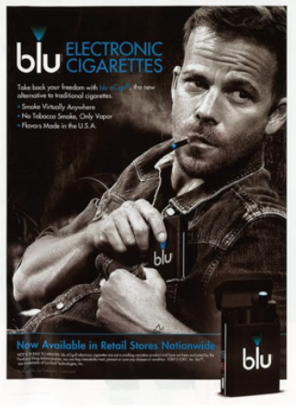
Notes:
Current vaping ad.

Slide 8
Notes:
Comparison of the two.

Slide 9
What did you notice?
Notes:
Asked students what they noticed between the two pictures. Students pointed out the similarities and how these ads are appealing to teens.

Slide 10
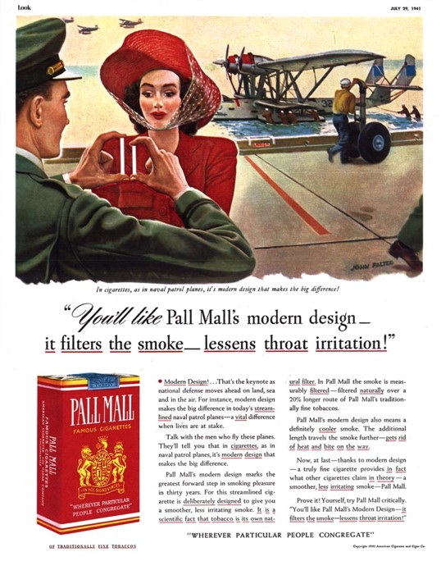
Notes:
Past cigarette ad.

Slide 11
Notes:
Current vaping ad

Slide 12
Notes:
Comparison

Slide 13
What did you notice?
Notes:
Repeat of the previous activity

Slide 14
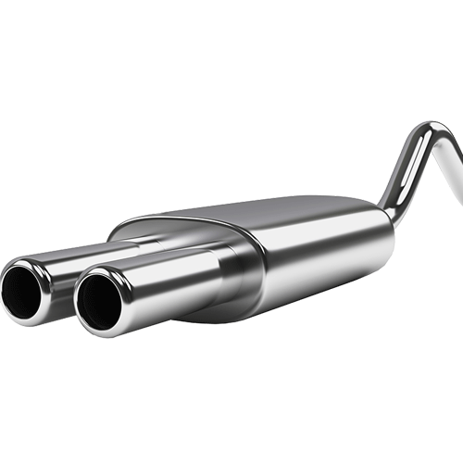
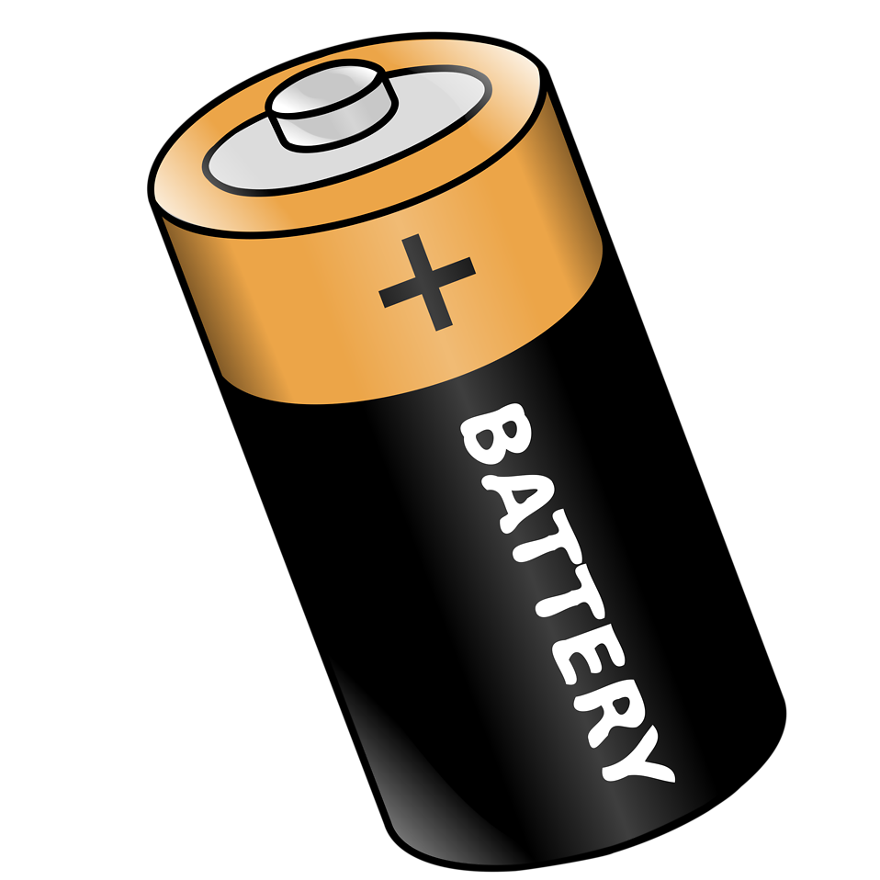
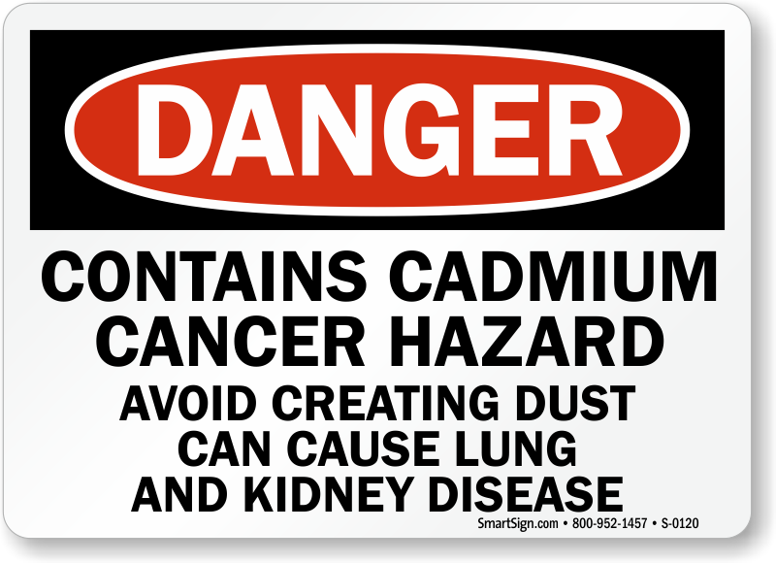
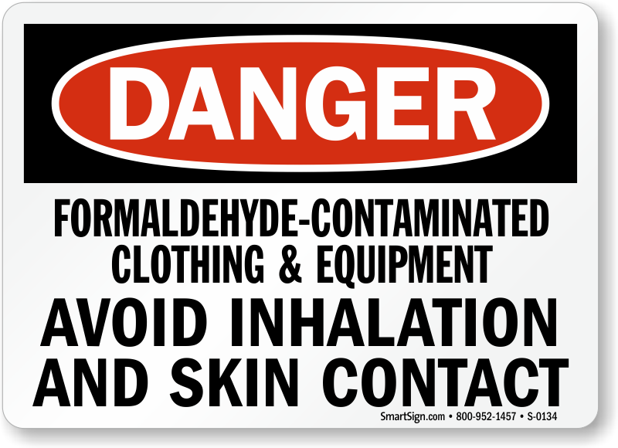
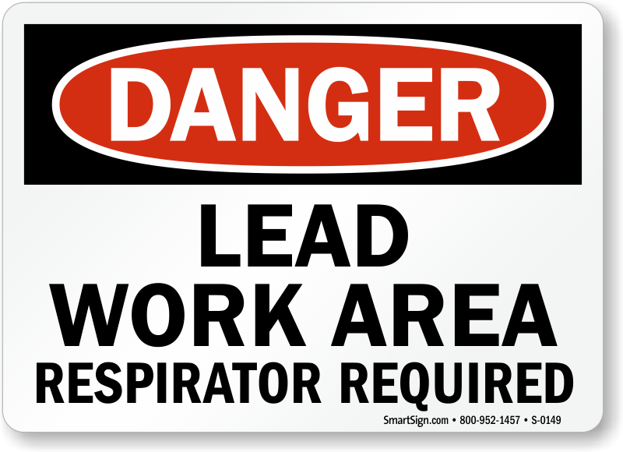
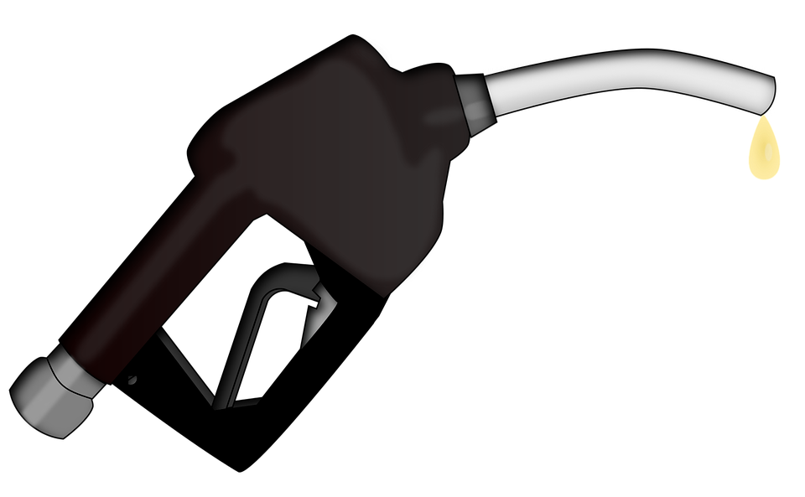
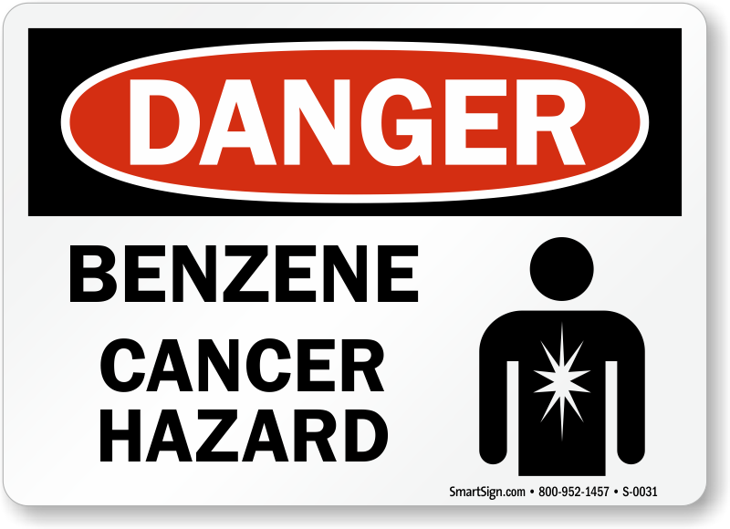
What is in a vape?
Notes:
Discuss with students what chemicals have been found in vapes.

Slide 15
38
Notes:
“38 of the 93 chemicals and carcinogens that are listed on the FDA’s “Harmful or Potentially Harmful Constituents” (HPHC) list are found in vapes.”
When walking in to the classroom 38 students were given a red card. When this slide appeared, each of those students stood up. This was a visual representation of the number of harmful or potentially harmful chemicals that have been identified in vapes.

Slide 16
38 of the 93 chemicals and carcinogens that are listed on the FDA’s “Harmful or Potentially Harmful Constituents” (HPHC) list are found in vapes.
Notes:
About 40% of all of the chemicals identified by the FDA as harmful have been found in vapes.

Slide 17
Health effects
Young people who use nicotine products in any form, including vapes, are uniquely at risk for long-lasting effects.
Nicotine addiction
Makes the brain want other drugs
Nicotine in any form is a highly addictive drug.
Mood disorders
Brain development problems

Slide 18
School effects
Attention problems
Memory problems
Makes learning more difficult
Impulse control

Slide 19
Ways to say “No”
No, I have a big game tomorrow.
No, I have a test I need to study for.
No, thanks. I’m good.
No.
No, my friends and I are leaving.
No, I don’t want to.
No thanks, it is not healthy.
No, I promised my parents I wouldn’t.

Slide 20
Four things to think about when YOU are making healthy choices:
Mindset
Nutrition
Sleep
Chemical Health

Slide 21
PSA’s (Public Service Announcement)

Slide 22
Students are making healthy choices and not using vapes!

Slide 23
References
https://e-cigarettes.surgeongeneral.gov/
https://www.cdc.gov/tobacco/basic_information/e-cigarettes/index.htm
https://www.drugabuse.gov/publications/drugfacts/electronic-cigarettes-e-cigarettes
https://www.fda.gov/TobaccoProducts/Labeling/ProductsIngredientsComponents/ucm20035927.htm
https://www.drugabuse.gov/drugs-abuse/tobacconicotine-e-cigs

