Slide 1
Why Failure Matters
Building Capacity to Reach Your Goals
Illinois Human Performance Project

Slide 2
Training Objectives
After this training participants will be able to
Define Resilience and talk about why it is important for achieving their goals.
List ways to build mental, physical, social, and emotional resilience.
Explain the value of failure and why it is an important part of the journey toward achieving a goal.

Slide 3
Notes:
Identify your goal.
Set up a diagram on the board with a road leading toward the word “goal”.
We all have something in life that we’re working towards, whether it’s a dream career, going to college, graduating from high school, or passing your next math exam. Please take 2 mins to think of a goal. It can be something you’re trying to achieve next week, or long term in the future. Whatever it is that you connect to most right now. Write it down on your handout.
Optional: ask everyone to identify two goals, one personal and one for your HPP Chapter.

Slide 4
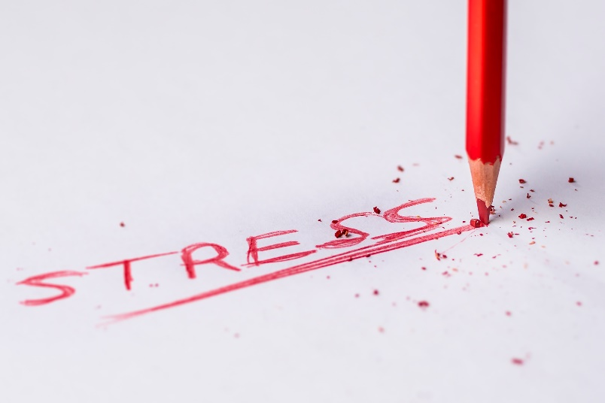
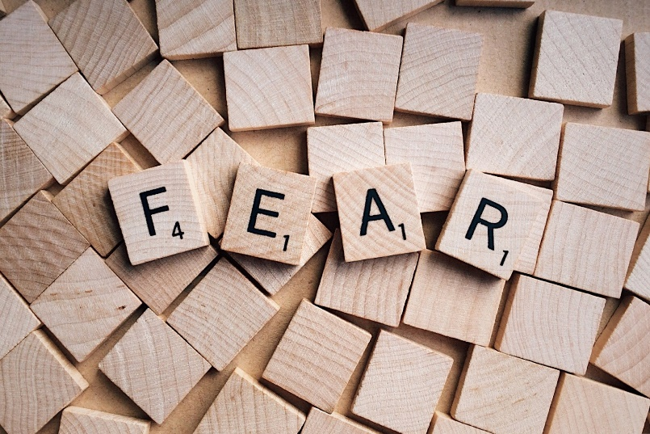
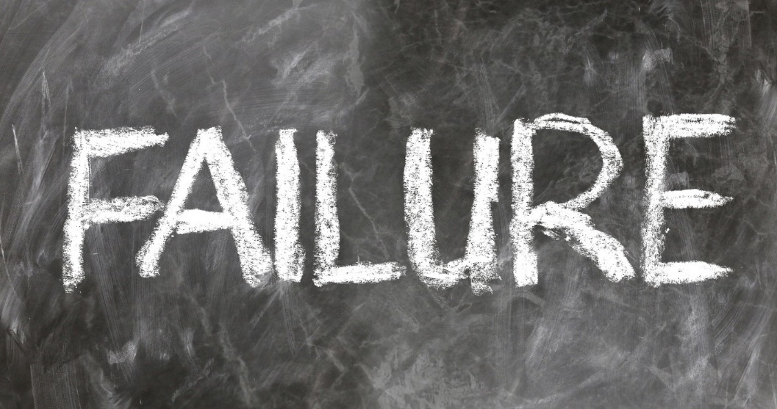
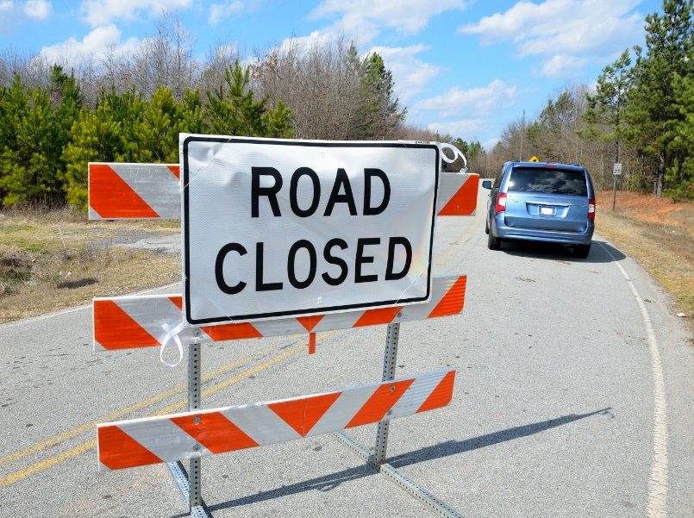
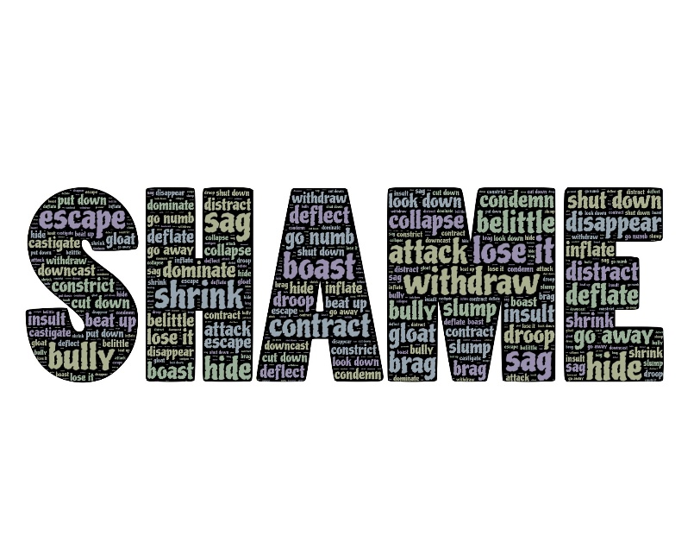
Notes:
Ask the class to define failure and invite several responses. After discussing the definition of a failure, share a couple of your own failures to get the students thinking about the ones they have had.
How can we define failure? What does it mean?
Now I want you to take another 2 mins and think about a challenge you might face while trying to reach the goal you just identified.
What might get in the way of reaching that goal?
What obstacle might you encounter? What obstacle are you trying to overcome right now? The problem can be related to anything from school, friends, family or work. Anything that is holding you back from achieving what you want.
*If time permits and group is comfortable, ask for examples of personal goals and possible roadblocks.

Slide 5
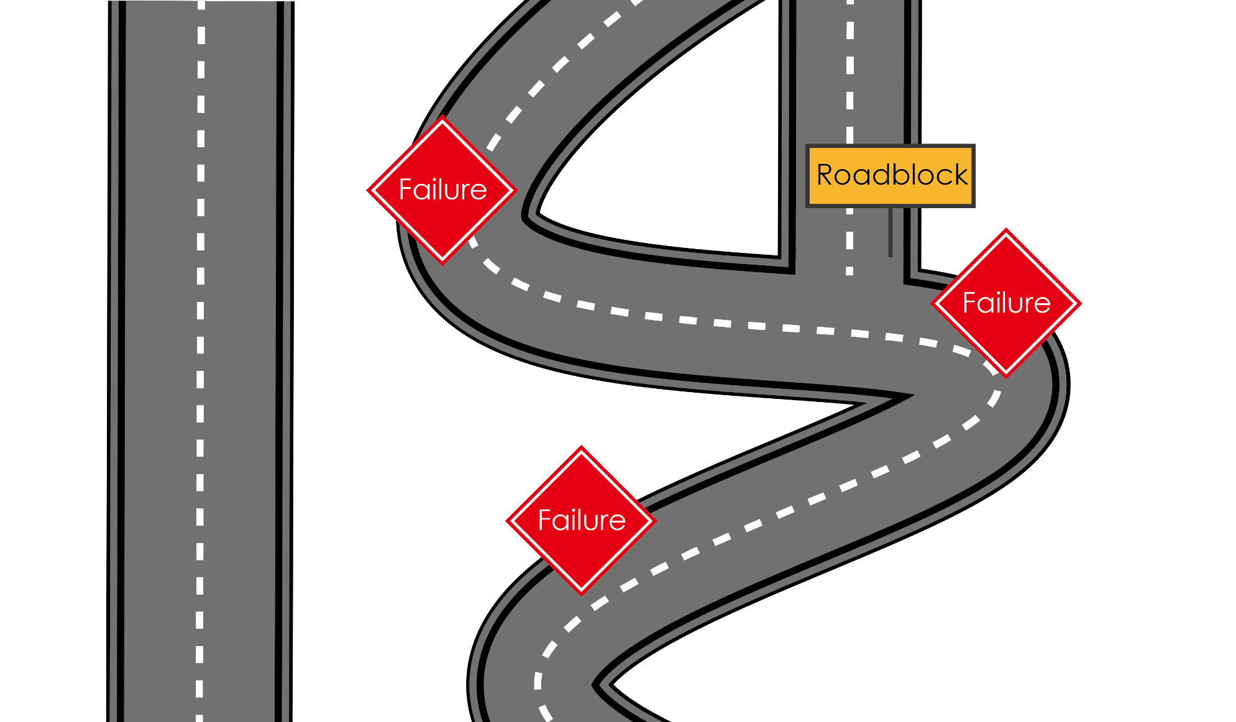
The Road to Success
Failure does not mean the end of the road.
Perception vs. Reality
Notes:
The road to achieving your goals is not always going to be smooth. You will run into roadblocks. Failure, at some point, is inevitable in all of our lives.
But failure does not have to mean the end of road. The difference between someone who is successful and someone who is not: the successful person has the ability to see failure as an opportunity, not an end.
When we identify our goals, we create a vision for ourselves. The challenge comes when we start to believe we can’t reach our goals; when we have to make a choice to continue working toward our goals in spite of hardship.

Slide 6
Notes:
Show you a clip from The Pursuit of Happyness (2006).
Will Smith plays a single father named Chris Gardner. Evicted from their apartment, he and his young son (Jaden Christopher Syre Smith) find themselves alone with no place to go. Even though Chris eventually lands a job as an intern at a brokerage firm, the position pays no money. The pair must live in shelters and endure many hardships, but Chris refuses to give in to despair as he struggles to create a better life for himself and his son.
Watch clip
In this clip, we see Chris do an interesting thing. He puts his son down – his dream is unrealistic, he needs to aim for something else. And we can see how it totally deflates his son. Has anyone ever experienced this? Have you ever felt that deflation? You’re excited about a project or a career path, and then someone comes along and says, “Mmm maybe not. You probably can’t do that.” And the sad thing is, when that happens to us, we often consciously or subconsciously respond by shrinking our dreams down. By making ourselves smaller.
We want to avoid failing, to avoid disappointment.
What I love about this clip, is that it takes an encounter that many of us can relate to – being put down for having an unrealistic dream – and it turns it on its head. “Don’t ever let somebody tell you that you can’t do something.” If you want to change your goals, as you grow and discover new opportunities, then go ahead. But letting discouragement from other people and our own fear of failure control us, will only lead to us having an incomplete story.
This movie is not about one huge obstacle you will overcome one day. The pursuit is everyday, everyday you have to be working on your dream despite what people say.

Slide 7
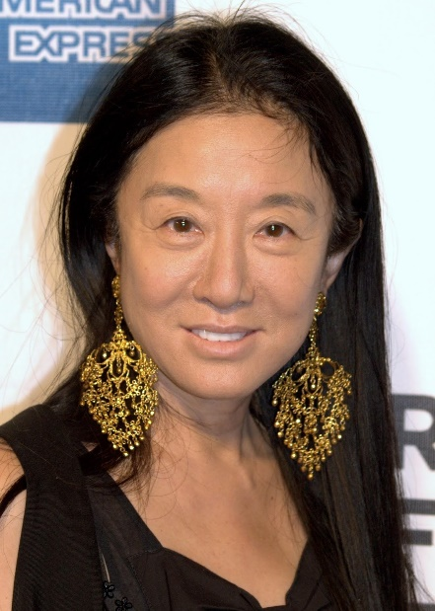
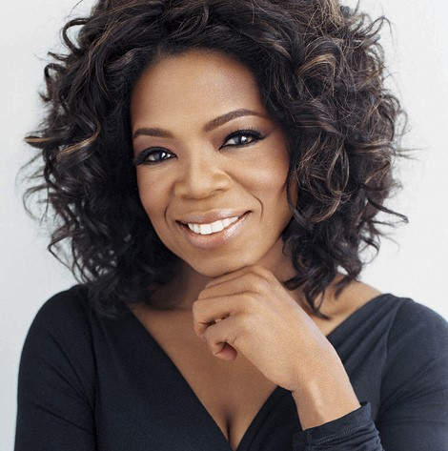
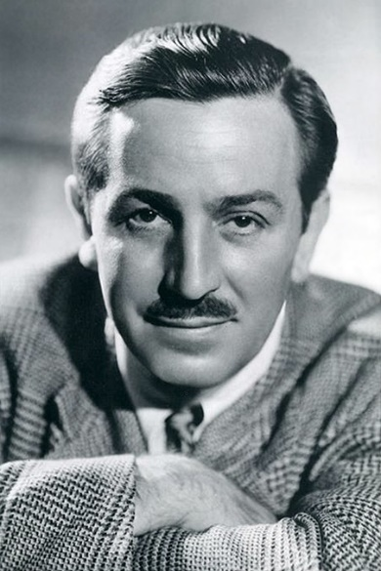
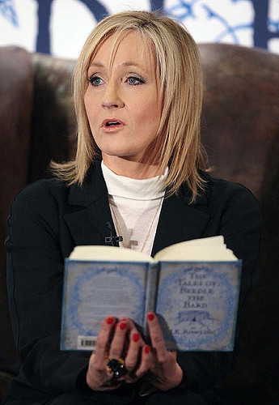
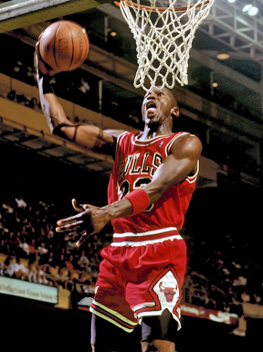
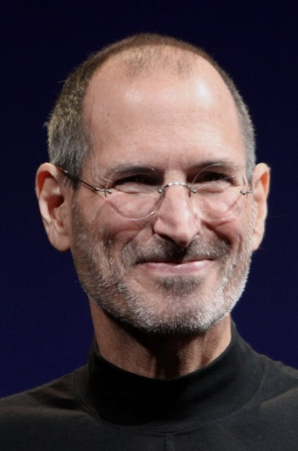
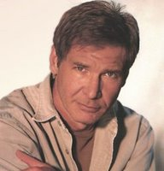
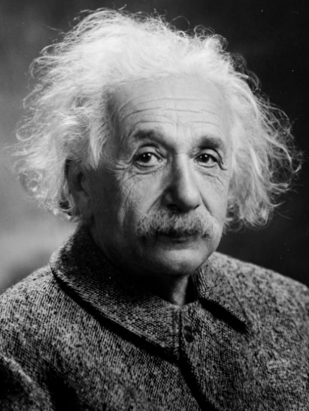
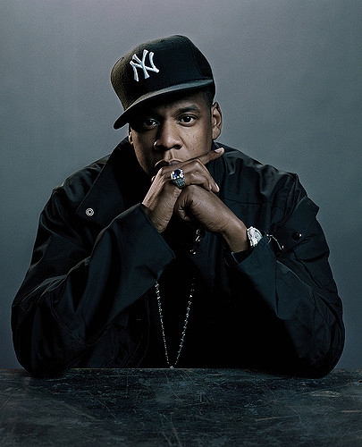
Notes:
Can you name any of these people or tell us what they are known for? Can you guess what all of these people have in common?
They are all extremely successful people in their fields – some of the best in music, sports, TV, science, fashion, etc. But each of them had to experience failure, sometimes over and over again, in order to reach success. Their experiences could have have been immensely discouraging, but they believed in their dreams.
DETAILS ABOUT EACH:
-Oprah Winfrey was fired from her job as a television reporter at the age of 22 because she was unfit for TV and was “too emotionally involved with the stories.”
-Walt Disney was fired by the editor of a newspaper because “he lacked imagination and had no good ideas”
-JK Rowling was rejected by 12 different publishers and told that she wasn’t going to make any money writing children’s books.
-Michael Jordan went home, locked himself in his room and cried after his friend made the varsity basketball team and he didn’t.
-Vera Wang wanted to be a professional figure skater, but she didn't make the U.S. Olympics team in 1986. It was only then that she snagged a retail job at a Yves Saint Laurent boutique in New York City and found herself at Vogue two years later. A failure is at the root of her fashion empire. “When you fall down—which you have to [do] if you want to learn to be a skater—you pick yourself right up and start again," -Steve Jobs had to drop out of college because he couldn’t afford it, was once fired from Apple (the company he started), and suffered from severe depression.
-When Beyonce was young (‘93), her group, Girl’s Tyme, competed on “Star Search” (the American Idol of those days). They lost to a group called Skeleton Crew. She didn’t let failing on national television end her musical ambitions though. She went on to form one of the biggest girl groups of its time, Destiny’s Child, before launching her own successful solo career.
-Harrison Ford was told by the movie execs of his first film that he simply didn’t have what it takes to be a star.
-Today the word "Einstein" is synonymous with genius, but young Albert didn't speak fluently until he was nine-years-old, causing teachers to think he was slow. He was expelled from school for his rebellious nature and was refused admittance to the Zurich Polytechnic School.
-Jay Z wanted to pursue a record career, but no label wanted to sign him. So he opted instead to selling CDs out of the trunk of his car. Every major label had turned him down, so he did what any enterprising young individual would do that was committed to succeeding — he co-founded his own label called Roc-A-Fella Records

Slide 8
If you’re trying to achieve, there will be roadblocks. I’ve had them; everybody has had them. But obstacles don’t have to stop you. If you run into a wall, don’t turn around and give up. Figure out how to climb it, go through it, or work around it.
- Michael Jordan
Notes:
Have someone read quote.
As he says, everyone will have roadblocks. I will have them and you will have them. But they are not the end of the road! For Michael Jordan, it was an opportunity to work harder and never stop believing in himself and what he could achieve. He used his failure to motivate himself for success!
What if we look at someone from a different kind of career?

Slide 9
Getting fired from Apple was the best thing that could have ever happened to me. The heaviness of being successful was replaced by the lightness of being a beginner again, less sure about everything. It freed me to enter one of the most creative periods of my life.
- Steve Jobs
Notes:
This is a quote from the commencement speech Jobs gave at Standford University. Ask someone to read the quote.
Steve Jobs actually credits his success directly to his experience of failure. Our world wouldn’t be what it is today if he had not gotten fired.

Slide 10
Failure taught me things about myself that I could have learned no other way. I discovered that I had a strong will, and more discipline than I had suspected.
- J.K. Rowling
Notes:
It turns out that failure actually gave Rowling something that success never could.
Have someone read the quote.
Think about that. Rowling emerged wiser and stronger than ever.
That’s something I want you to remember. When you make mistakes or fail at something that is important to you - you’re rejected or embarrassed - it doesn’t have to beat you down. Let it teach you something about life and what you can do. Rowling made millions of dollars because of Harry Potter, but that is not the true definition of her success. She was successful because she gained that inner security by staying committed to her dreams through failure.
(Rowling wrote a whole book about the benefits of failure. One of the things she says in here, is
“It is impossible to live without failing at something, unless you live so cautiously that you might as well not have lived at all – in which case, you fail by default.")
Transition into activity: So learning from failure was a key component in the lives of these very succesful people. We are going to do an activity to bring this perspective into our own lives.

Slide 11
Notes:
Failure Toss activity: http://oncourseworkshop.com/life-long-learning/failure-toss/
Students fold sheets of paper in half vertically. At top of the left-hand column write “FAILURES.” Students make a list of their failures in school and in life. No one else is going to see their failures, and even though they are in groups, this part of the exercise will not be shared. Have them number each failure. (5 minutes)
At top of the right-hand column write “WISDOM.” In this column, have them write any valuable wisdom they learned from each of their failures. Give an example. Tell them they can have many “wisdoms” for each failure (5-10 min)
Have a volunteer in each group read one wisdom to the rest of their group (not the failure). Instruct them to keep going around the group clockwise, with each person reading one wisdom each time (with the option to “pass” if they wish). Read only wisdom and do not go into detail about how they learned the wisdom. Keep going around the group until all in the group have stated all of their wisdoms). (5 minutes – may choose to end this earlier if time is an issue)
Instruct students to tear their papers in half along the fold. Have them choose from the following four options:
Keep both your FAILURES and WISDOMS
Throw away FAILURES and keep WISDOMS
Throw away WISDOMS and keep FAILURES
Throw away both WISDOMS and FAILURES
Tell them if they choose to throw anything away, to ball up their papers and toss them in the trash can. There is no “correct” choice.
In a journal style or class discussion, have the students answer the following questions:
What choice did you make? Why? What is the life lesson in this experience?

Slide 12
Resilience
The ability to stay motivated, optimistic, and determined even in the face of tough challenge.
BOUNCE BACK!
Notes:
Failure matters because it teaches us how to be resilient. How many of you have heard the word resilience before? Can anyone define it?
Resilience is “the ability to stay motivated, optimistic and determined even in the face of tough challenge.” To simplify it, resilience is when you can bounce back.
*relate the definition back to the stories that were just shared.
We know that resiliency is an important character trait, and that some people seem to have more of it than others. Luckily for us, it is not something you’re either born with or without, but it is something you can build and foster within yourself.

Slide 13
Four Types of Resilience
Physical
All four work together to build your capacity to overcome challenge.
POWER UPS can help build resilience!
Social
Mental
Emotional
Notes:
It’s easy enough to define resiliency and recognize it’s importance, but how do we foster it in ourselves?
One way to make this easier for ourselves, is to break resiliency down into four categories. We can be resilient physically, emotionally, mentally, and socially.
We want all four types of resilience because they all intertwine and work together to increase our capacity to overcome challenges. It is important to note here that building resilience doesn’t happen overnight. It is not an immediate process, but it doesn’t have to be complicated either. What we are going to do now, is walk through four categories that will help us increase each type of resilience. These are simple activities that, when utilized over an extended period of time, will build our resilience.
Think of these exercises as power ups – like drinking a cup of coffee in the morning, but even better. These are little things you can do every day to give yourself a boost when you need it.

Slide 14
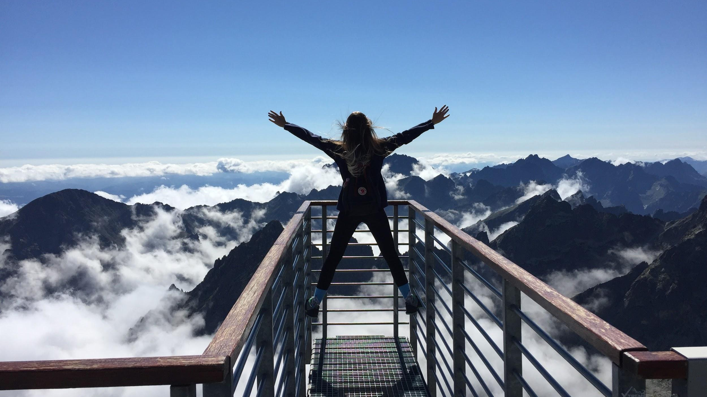
Activity One
Notes:
Everyone ready for our first activity?
Make your hands into fists, and raise them over your head as high as you possibly can for five seconds!
Well done! Just by giving your body a quick physical activity you have boosted your Physical Resilience - which means your body can withstand more stress and heal itself faster.

Slide 15
Stand up and walk 3 steps.
Physical
Resilience
Walk around your block.
What else?
Stay hydrated – drink water regularly throughout the day.
Flex your limbs for 5 seconds each.
Notes:
Research has showed us that the number one way to increase your physical resiliency is simply to NOT SIT STILL.
Each second that you choose not to sit still, you are choosing to imrpove the health of your heart, lungs, and brain.
Take time to write down some of the group’s ideas about how to increase physical resilience and not sit still, encourage everyone to take notes for themselves to keep after the presentation.

Slide 16
Activity Two
A
B
ocean / breeze
leaf / tree
sweet / sour
movie / actress
gasoline / engine
high school / college
turkey / stuffing
computer / chip
chair / couch
bread / b_tter
music / l_rics
sh_e / sock
phone / bo_k
chi_s / salsa
pen_il / paper
river / b_at
television / rad_o
l_nch / dinner
Notes:
Take a few seconds to look at these two lists. Spend the same amount of time on each one.
*Allow for 30-40 seconds, about 20 seconds for each list.
Now without the lists in front of you, try to remember as many of the word pairs as you can. Turn to the person next to you, and list any that you can think of.
By show of hands, from which column do you recall more words? A or B?
By majority, people usually remember more of the words from column B, the list that contained fragmented words. Why did this happen? It’s not as if we were suddenly touched by genius while reading the second list.
Something subtle happened when you reached the second list. Your brain stumbled for a moment, and has to take an extra second on each pair before it made sense. That moment of struggle is crucial. The tiny challenge gave you more focus and sharpened your memory skills. Doing an exercise like this boosts your mental discipline, determination, and willpower.
Willpower works like a muscle, it gets stronger the more you exercise it. The more tiny challenges you can finish without giving up, the more you are exercising that muscle.

Slide 17
Notes:
https://www.youtube.com/watch?v=KgzLzbd-zT4
1-2 minutes

Slide 18
Make your bed every morning.
Mental
Resilience
Complete a puzzle.
What else?
Count backwards from 100 by 7.
Snap your fingers 50 times in a row.
Notes:
Staying focused and accomplishing small tasks is important for building mental resiliency. What are other small tasks or mental exercises that you can do every day to build mental resilience?
Any experience where you’re forced to slow down, make errors, and correct them end up making you more skilled and resilient, without your realizing it.
Moving on to our third activity.
Encourage students to write down ideas for how they can improve their own mental resilience.

Slide 19
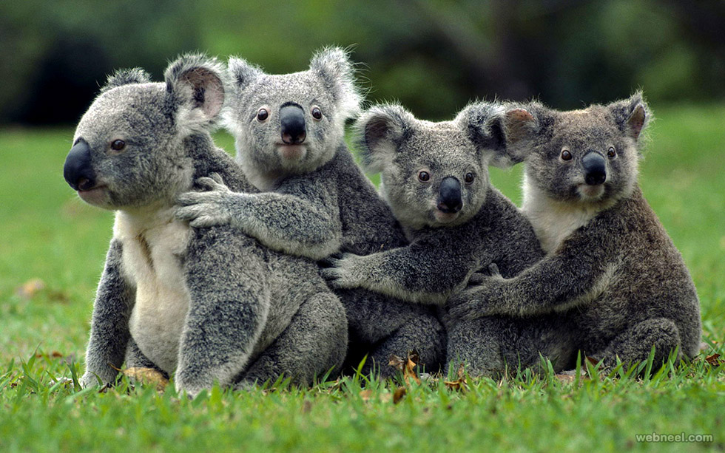
Activity Three
What’s your favorite animal?
Notes:
Activity
Animal pictures!
Pull out your phone and do a YouTube or Google image search for your favorite “baby (animal)”
We are going to throw some up here now…

Slide 20
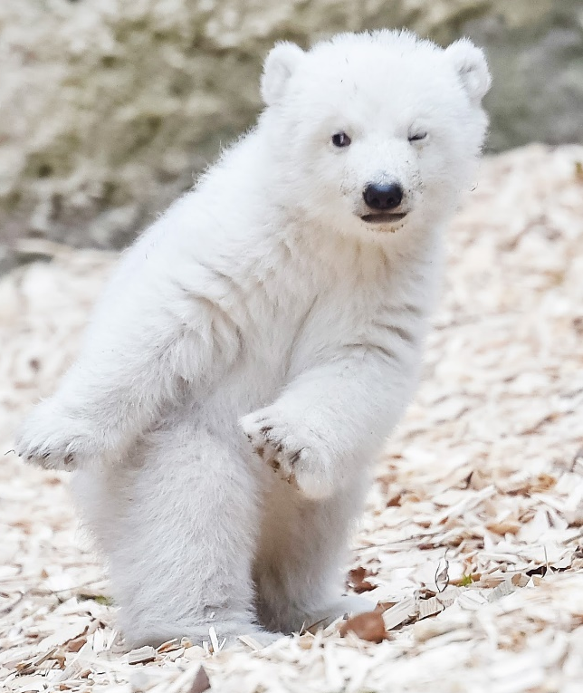
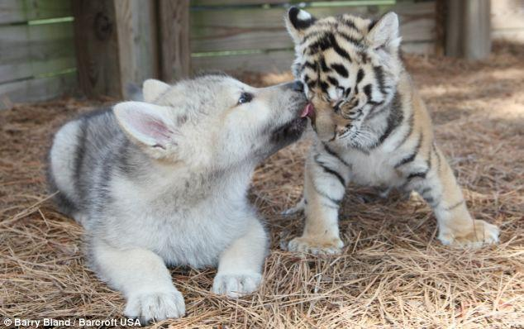
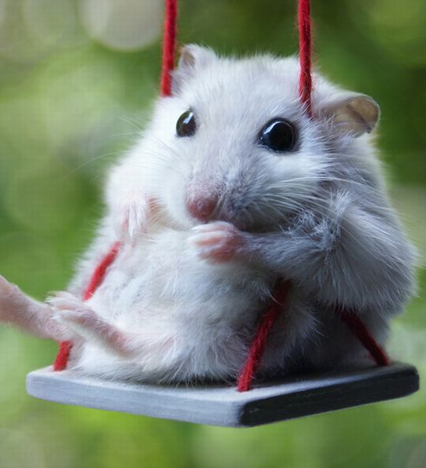
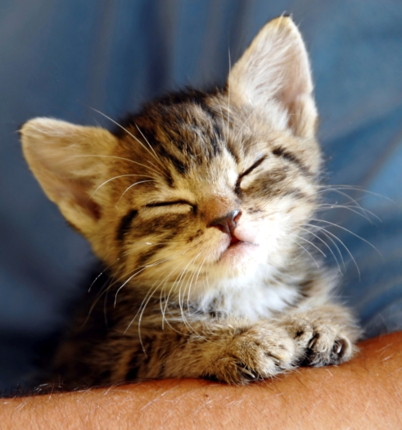
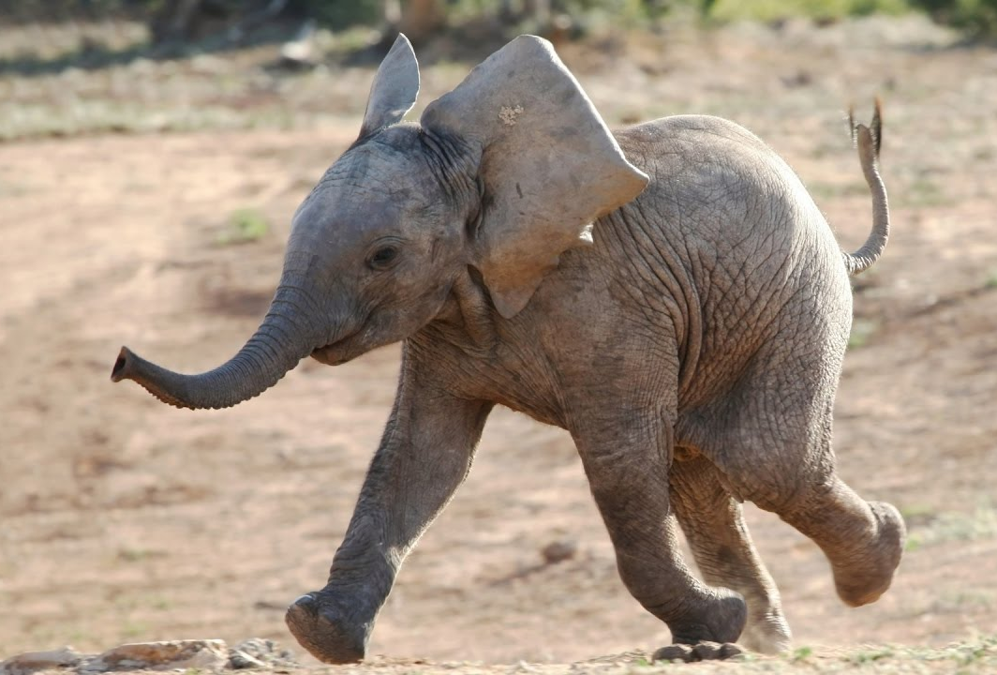
Search: “Baby ______ (insert favorite animal)”
Notes:
Ask the group what they feel when they look at these pictures.
Most people would say they have a strong postive emotional reaction when they look at a picutre of their favorite baby animal. Why is this important?
Positive emotions like curiosity, pride, excitement, love, and amusement don’t just feel good, but they actually make you stronger! Research says positive emotions boost your immune system, protect your heart, and help you grow neurons faster. They also increase your creativity, your stamina, and your willpower.
Positive emotions are vital to our health. Doing this exercise shows you that you have the ability to evoke powerful emotions like curiosity or love when you need them most (just by looking at these pictures!). What else can we do every day to elict these postive emotions?

Slide 21
If you’re inside, find a window to look out of.
Emotional
Resilience
Watch a video that makes you laugh.
What else?
Give yourself a hug.
Do three small things each day that make you feel good.
Notes:
Do three small things -- this is actually where I want to tell you about a great method for emotional resilience - it’s the 3 to 1 ratio. This means that for every 1 negative emotion or thought you have, you want to achieve 3 positive emotions. We have this method because we know that realistically, it would be impossible to be positive all the time (and probably kind of annoying).
Sometimes we feel sad, angry, and hurt. But countering those negative emotions with the 3 to 1 ratio will improve your health and your ability to tackle challenges!

Slide 22
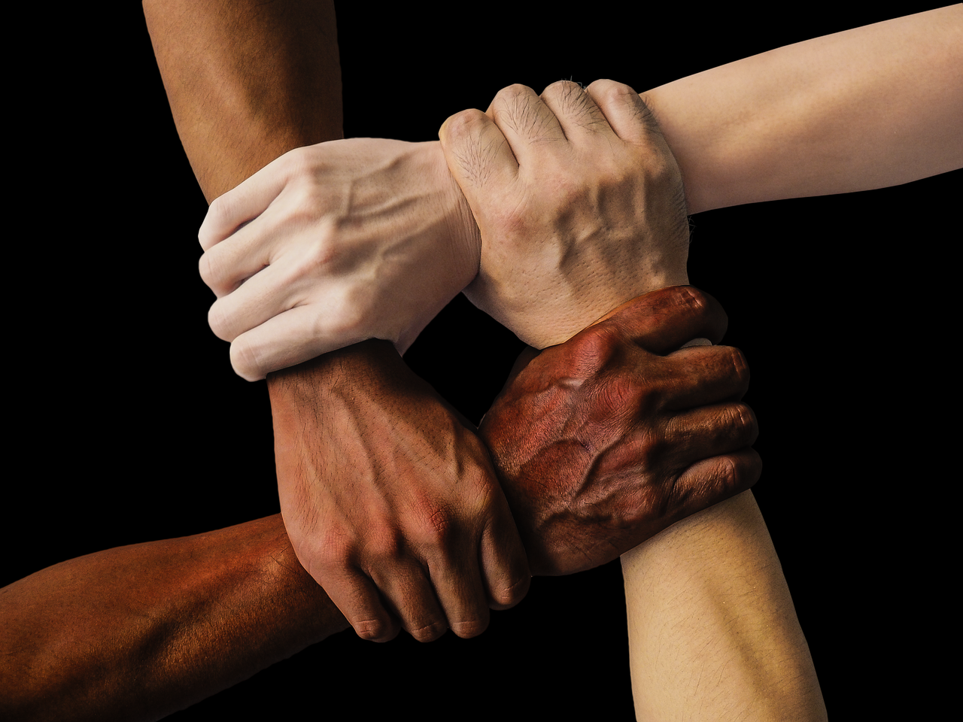
Activity Four
Shake hands with someone else for 6 seconds.
Notes:
Activity
Moving on to the last one, social resiliency.
Shake someone’s hand for 6 seconds or write a note. You can use index cards, or you can text them with your phone -- sending a quick note of gratitude, or even just that you’re thinking about them.
Okay great! So the note thing is pretty obviously helping to create a link -- why the handshaking?
Studies show that shaking someone’s hand for 6 seconds will actually create a biochemical link, which makes you more willing to like and want to help each other. This is because there is an increase of oxytocin in your bloodstream, which is the trust hormone.
So why is social resiliency so important and what are other ways to build it?
Offer other activity option if you have time:
-Write a note of appreciation to give to someone who is important to you.

Slide 23
Be present and listen to your friends.
Social
Resilience
Spend time with people who
make you smile.
What else?
Say thank you to someone that
matters in your life.
Hang out with people who allow you
to be yourself.
Notes:
The truth is, the more teammates you have in life, the more likely you are to reach your goals. It is important for us all to feel connected with others and have that support.
Touch and gratitude are just two ways to strengthen your social connections.
What are other ideas that you have?
If you can reach out to one person a day, online, or face to face, you can continue to increase your social resiliency!

Slide 24
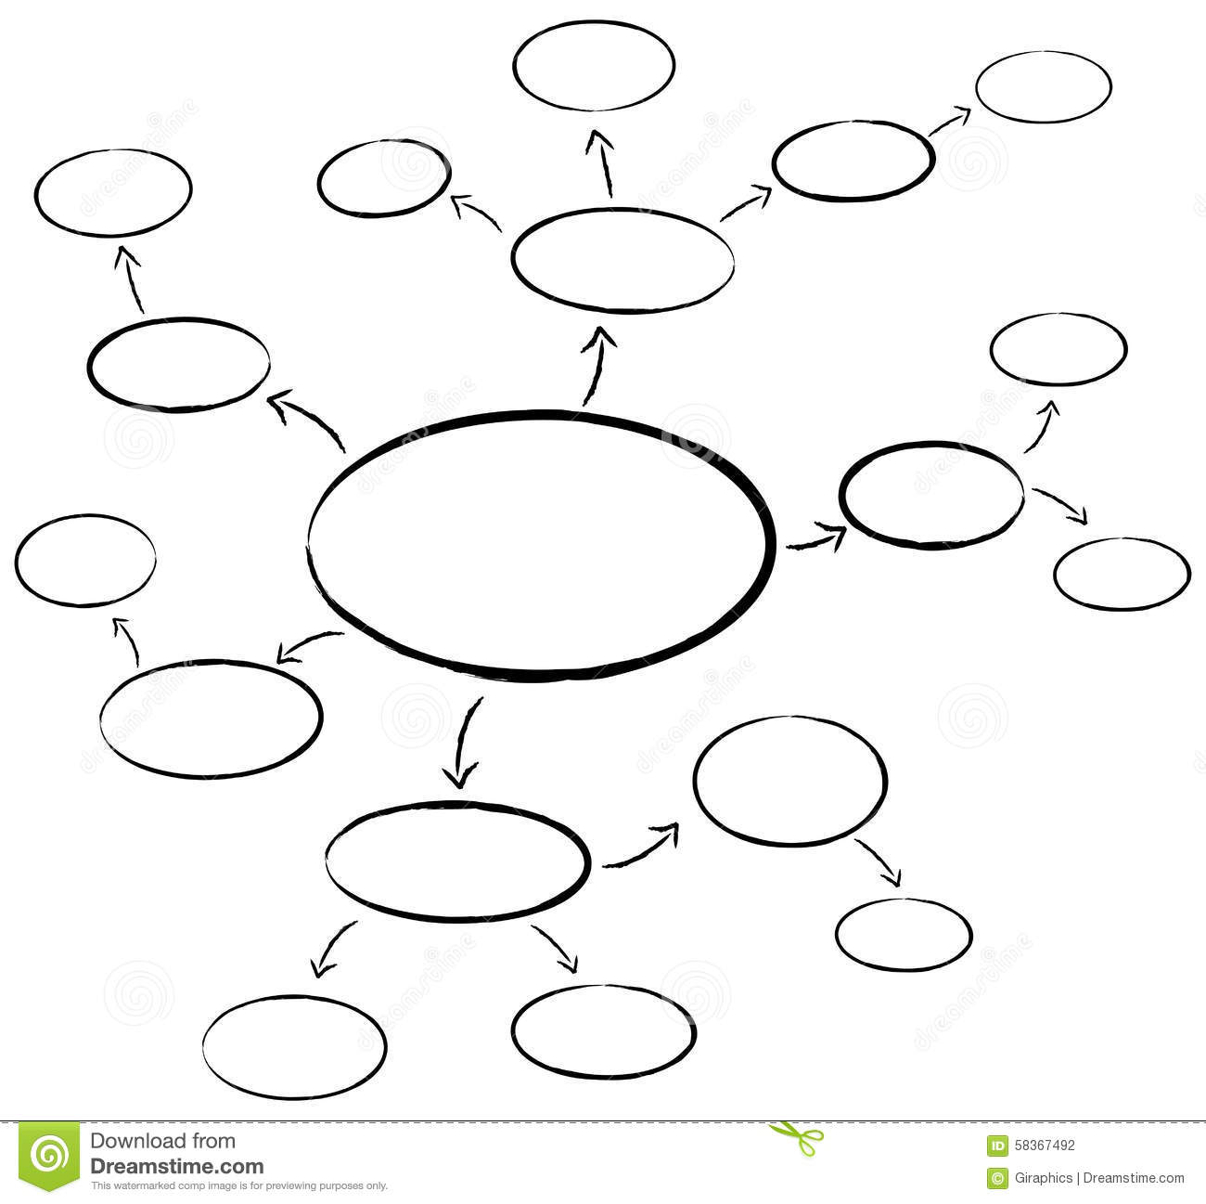
MIND
MAP
Notes:
Take time to create a mind map of words you connect to resiliency and power ups you can use to build that resiliency.
3-5 minutes
*A Resilience Mind Map worksheet can be found at ilhpp.org.

Slide 25
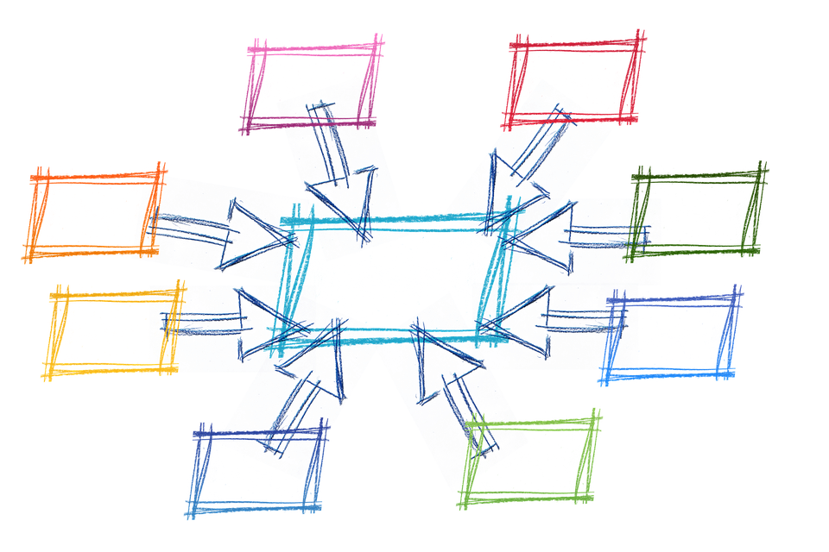
What Now?
Remember:
Failure is a pathway to success
Power-ups build resilience
Reach out to people you trust and let be your teammates as you work toward your goals!
Never stop believing in your dreams!
Notes:
Use your resiliency worksheets
Download the SuperBetter app on your phone!
Remember,
If you are never sitting still for more than an hour at a time
If you are tackling tiny goals to boost your willpower
If you can regularly boost that 3 to 1 positive emotions ratio
If you are reaching out to one person you care about every single day,
… you can increase your resiliency.
Resiliency gives you what you need to work through your obstacles and achieve your goals!

Slide 26
Failure is just opportunity in disguise. Never give up!
If Howard Schultz gave up after being turned down by banks 242 times, there would be no Starbucks.
If Thomas Edison had stopped after 1,000 unsuccessful attempts, there would be no light-bulbs.
If Walt Disney had quit too soon after his theme park concept was trashed 302 times, there would be no Disneyland.
Notes:
Believe in yourselves, and believe in your dreams. We hope the workshop today will help you see past your roadblocks, and if you bring that worksheet home with you and get in the practice of doing those simple activities every day, your resilience will be built these roadblocks will become smaller and smaller.

Slide 27
Sources
Coyle, D. (2010). The talent code: Greatness isnt born. Its grown. London: Arrow.
McGonigal, J. (2015). SuperBetter: A revolutionary approach to getting stronger, happier, braver and more resilient*. Toronto, Ontario, Canada: Viking.
B. (2015, January 19). Navy Seal Admiral Shares Reasons to Make Bed Everyday. Retrieved from https://www.youtube.com/watch?v=KgzLzbd-zT4
Wanderlust Worker. (n.d.). Retrieved from https://www.wanderlustworker.com/48-famous-failures-who-will-inspire-you-to-achieve/
Tindera, N. R. (2017, August 03). J.K. Rowling's Net Worth: $650 Million In 2017. Retrieved from https://www.forbes.com/sites/natalierobehmed/2017/08/03/j-k-rowlings-net-worth-650-million-in-2017/#4812834f1f30
This was developed and funded in whole and or part, by grants from the Illinois Department of Human Services and Substance Abuse and Mental Health Services Administration. The views, opinions, and content of this publication are those of the authors and contributors,
and do not necessarily reflect the views, opinions, or policies of IDHS, SAMHSA, or HHS, and should not be construed as such.

